Slide 1






Environmental Education Programme 2024/25
Green Prefect (GP) Programme
Online Briefing Session
(Secondary School)
Organisers
Funded By

Slide 2
Agenda
Section | Duration
1. Introduction | 7 mins
2. Effective Use of the E-handbook | 30 mins
3. Quiz Time: To Win Prizes! | 3 mins
4. Expected Outcome | 5 mins
5. Experience Sharing | 5 mins
6. Conclusion and Q&A | 10 mins

Slide 3
1. Introduction

Slide 4


Programme Background
Organisers
Funded by
Commenced in 2020,
Over 19,000 Green Prefects were nurtured

Slide 5

Programme Objectives
To enhance environmental performance of the participating schools
To develop a group of energetic and resourceful GPs with deeper understanding of environmental issues and acts as models for their peers
To enhance students’ environmental awareness and build up green habits on campus

Slide 6
Why do you join the GP Programme?

Slide 7
Can you name the environmental issues that concern you the most?

Slide 8

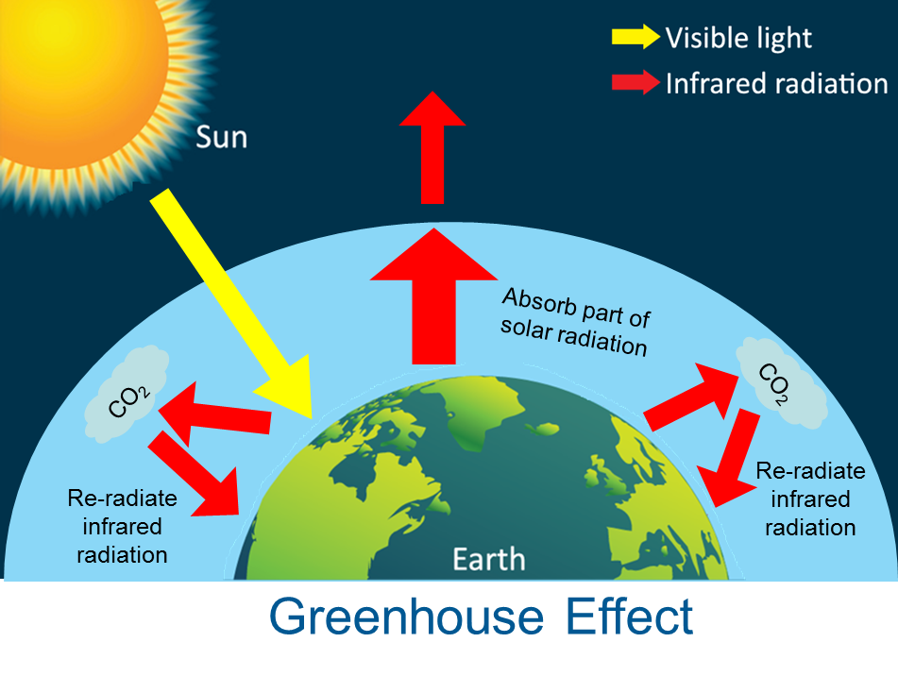
Climate Change
Global environmental threat
Mainly caused by human activities
  Emitting excessive greenhouse gases
  e.g. carbon dioxide (CO₂)
Impacts:
  Temperature rise;
  Sea level rise;
  Mass loss of ice sheets and sea ice;
  More frequent extreme weather events;
  and more…

Slide 9
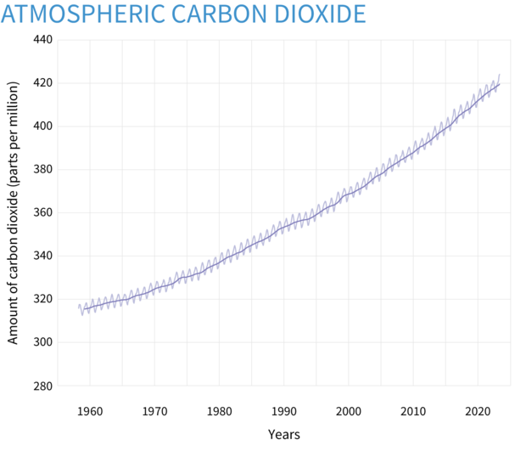
Greenhouse Gases
  Scientific evidence confirms that our Earth is facing a warming climate
  Concentration of carbon dioxide in the atmosphere recorded in September 2024:
422.03 ppm
Source: National Oceanic and Atmospheric Administration (2023)

Slide 10
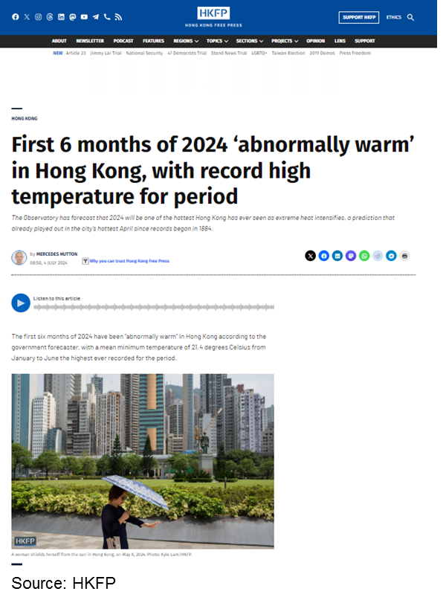
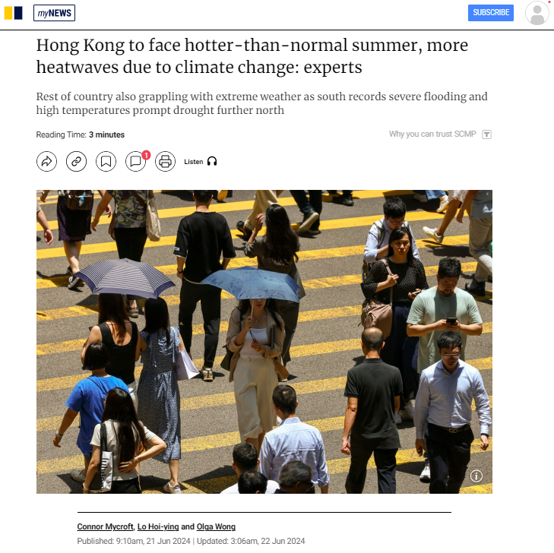
Climate Change
Source: SCMP
Notes:
https://www.scmp.com/news/hong-kong/health-environment/article/3267440/hong-kong-issues-very-hot-weather-warning-summer-solstice
https://hongkongfp.com/2024/07/04/first-6-months-of-2024-abnormally-warm-in-hong-kong-with-record-high-temperature-for-period-recorded/

Slide 11
How do you think climate change will impact Hong Kong?

Slide 12
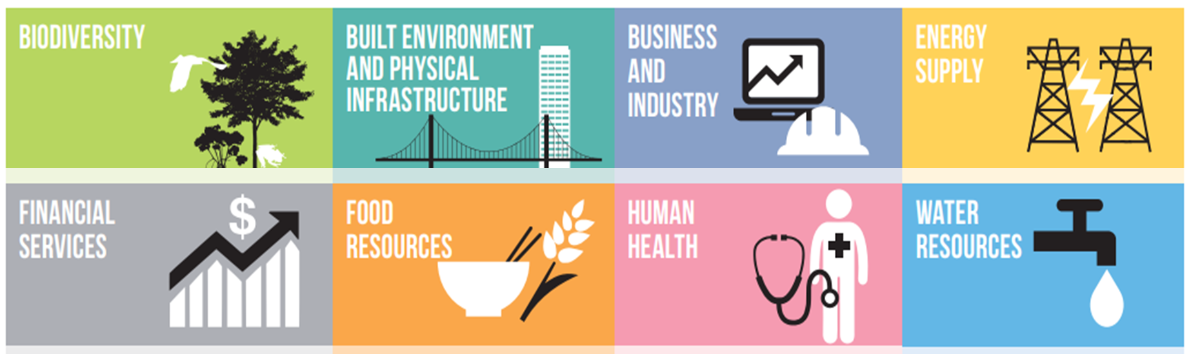
Possible Climate-related Impacts in Hong Kong

Slide 13
Let’s Guess!

Slide 14


Carbon and You
Which option has lower carbon footprint?
100g of meat
100g of vegetable/ fruit

Slide 15
Carbon and You
Which option has lower carbon footprint?
✓
100g of meat
100g of vegetable/ fruit

Slide 16
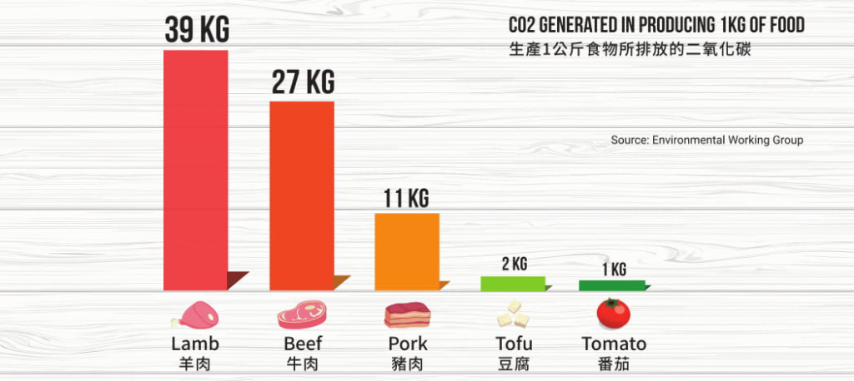
Carbon and You
Notes:
https://greenmonday.org/en/environmental-impact/

Slide 17
Small changes can have a
significant cumulative effect!

Slide 18
Welcome to join the GP Group!

Slide 19
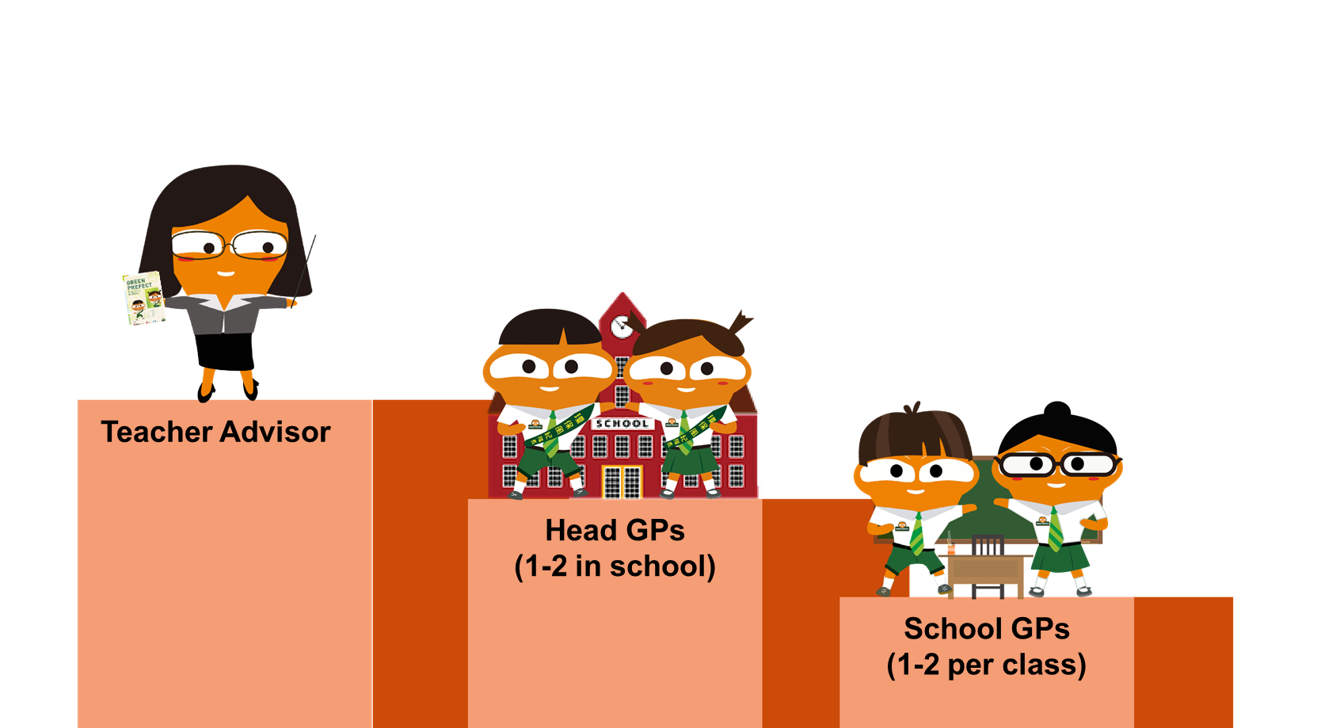
Recommended GP Group Structure
* Schools can modify and revise the GP Group structure according to its needs

Slide 20

Recommended GP Group Structure
Schools can modify and revise the GP Group structure and ways of appointment according to its needs, such as:
adjust the no. of appointed Head GPs and GPs
exempt the Head GPs, teacher-in-charge takes the responsibility of coordinating the Programme and activities
GPs of senior levels pair up with those of junior levels to assist the latter in performing their monitoring duties
only appoint senior students as GPs

Slide 21

Roles and Responsibilities
Head GPs (1-2 in school)
  Usually from senior levels
  To assist Teacher Advisor in managing the GP Group and organise environmental activities
  To be the spokesperson of the GP Group

Slide 22

Roles and Responsibilities
School GPs (1-2 per class)
  To monitor peers’ environmental behaviours as well as the school’s environmental performance with the aid of environmental checklists
  To act as role models for their peers in practising green living
  To encourage their peers to build up green habits on campus
  To follow instructions from the Head GPs

Slide 23



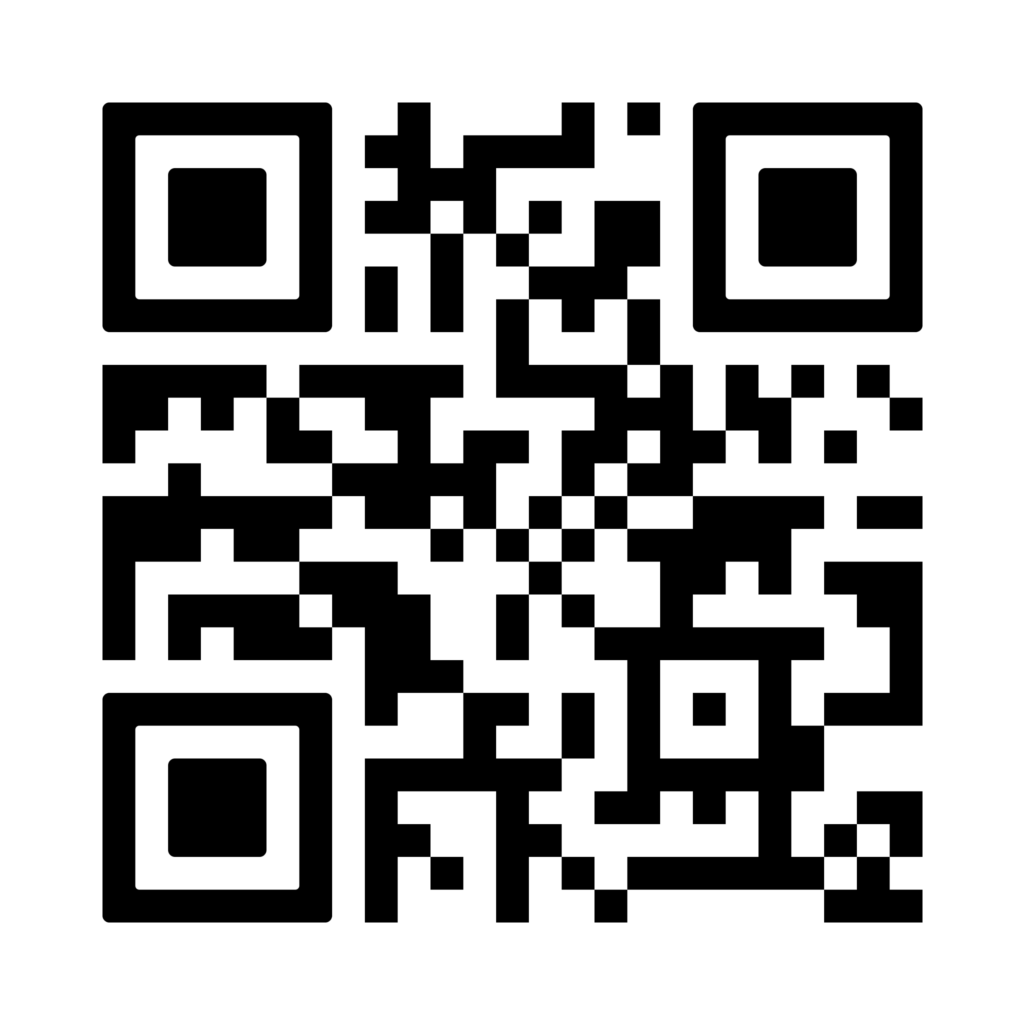
Appointed GPs will be given…
GP Handbook(e-version)
“Big Waster” Badge
“Big Waster” Shoulder Plush Doll
Downloadable from the Schools Go Green website
Will be distributed to participating schools via mail
To be collected by participating schools / participating schools arrange delivery service on their own

Slide 24


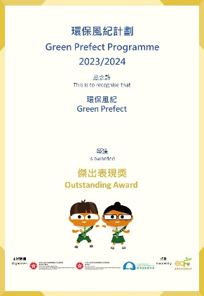

Awards for GPs
E-certificate templates (in editable pdf format) will be provided to participating schools at the end of the school year for issuance to GPs.
Outstanding Award
Certificate of Appreciation
Excellent performance while undertaking their duties and bringing positive influence to their peers’ green behaviours
Satisfactory performance and in appreciation of their dedication

Slide 25
Programme Timeline
Training Activities in the Programme
Online Briefing Sessions
(23 / 24 October 2024)
Inter-school Achievement Sharing Sessions
(Date to be confirmed)
Training Workshops
(Date to be confirmed)
Sep
Nov
Dec
Jan
Feb
Oct
Mar
Apr
May
Jun
Jul
2024
2025

Slide 26
Programme Timeline
Suggested activities to be organised by schools
Sep
Nov
Dec
Jan
Feb
Oct
Mar
Apr
May
Jun
Jul
2024
2025
Recruit GPs and set up a GP group
Formulate work plan and roster, set targets and arrange duties
Conduct monitoring duties with the Environmental Checklist every month
Organise environmental promotion activities
Hold meetings to review the monitoring progress
Conduct mid-term evaluation
Conduct year-end evaluation to analyse and review the programme effectiveness
Present certificates to commend GPs

Slide 27
2. Effective Use of the
E-handbook

Slide 28
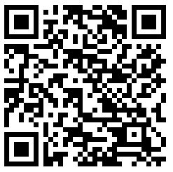
Introduction of the E-handbook
Downloadable from the Schools Go Green website
To Assist GPs to conduct their duties

Slide 29
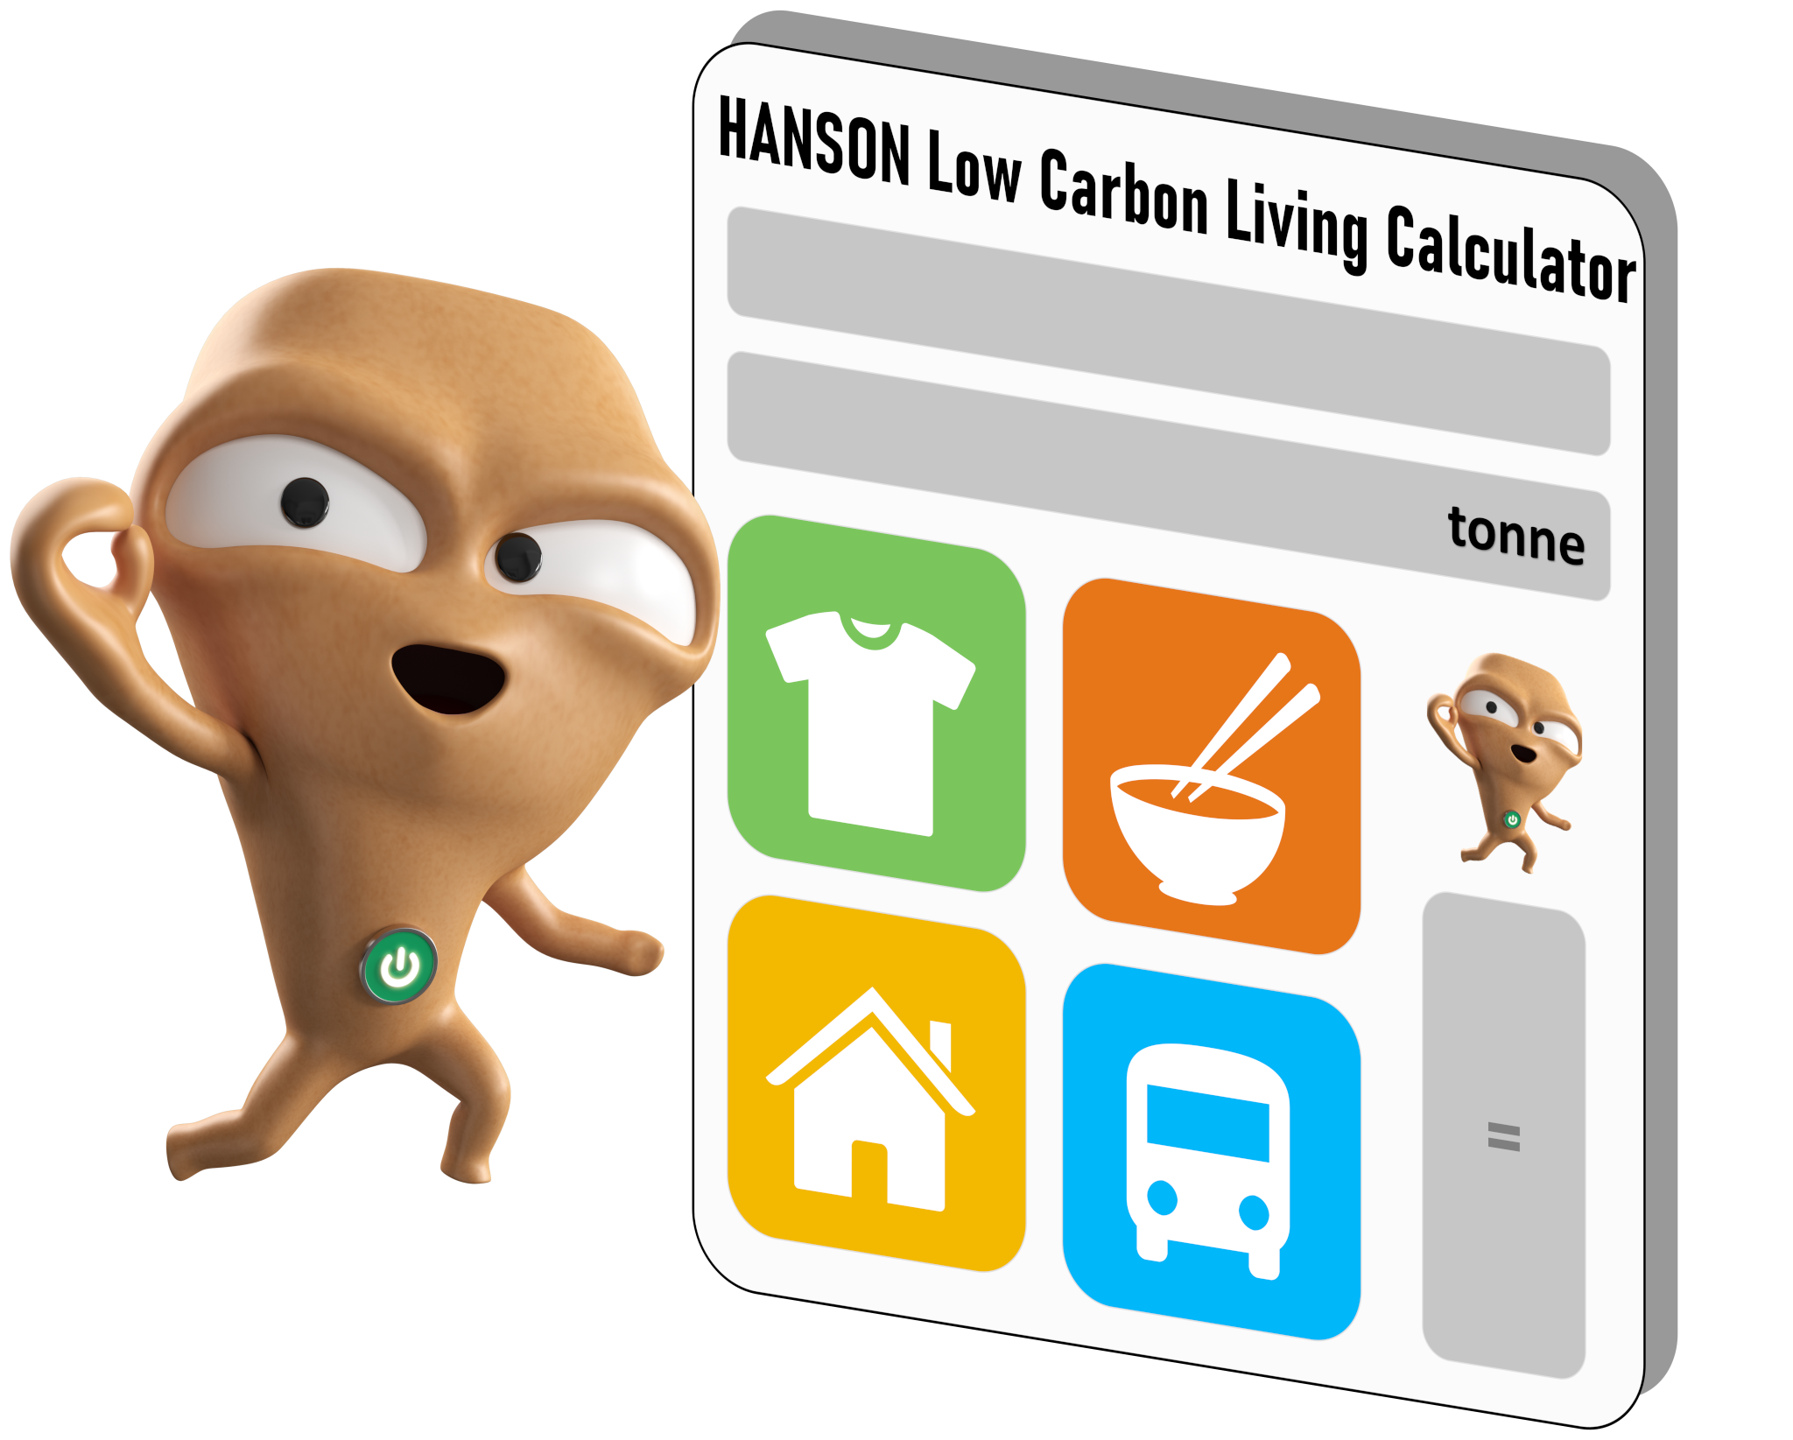
Self-reflection
To examine your own personal habits, identify and improve the areas where you can reduce your carbon footprint.

Slide 30
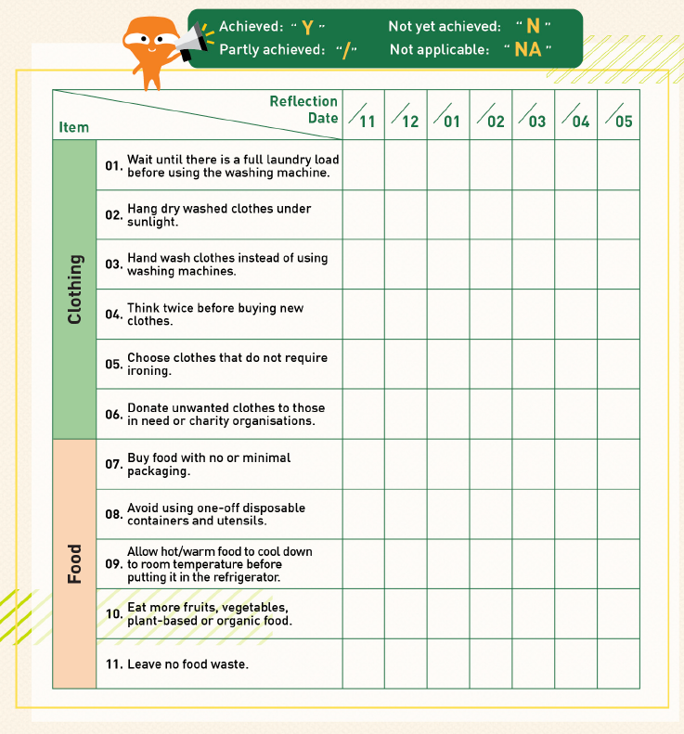

Self-reflection
Take a moment to reflect on your green behaviours in the past month and complete the self-reflection checklist in the e-handbook

Slide 31
What comes to mind when you think of sustainability?

Slide 32
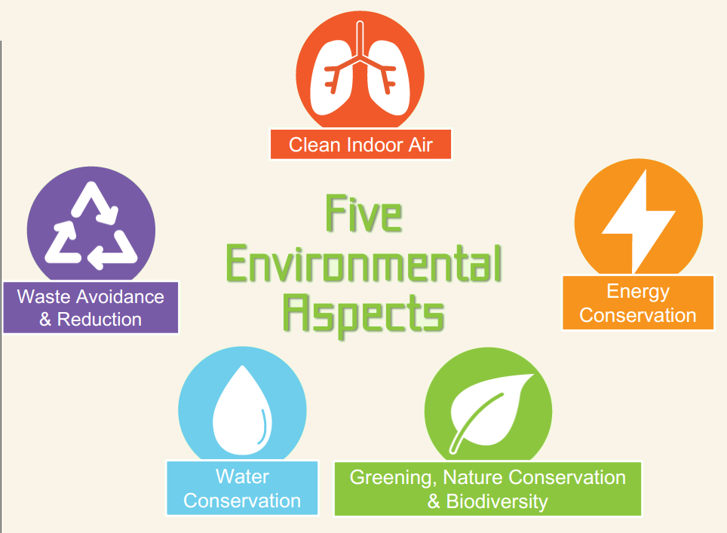

Slide 33

Which facility in the school generally consumes the most energy?

Slide 34
Answer: Air conditioners / Lights

Slide 35

What percentage of the total water on Earth is freshwater that is available for human use?
a. 20%
ｂ. 10%
c. 5%
d. <1%

Slide 36
What percentage of the total water on Earth is freshwater that is available for human use?
a. 20%
ｂ. 10%
c. 5%
d. <1%

Slide 37

Water resources on Earth
Polar ice caps
Freshwater available for human use: <1%

Slide 38

What percentage of the total greenhouse gas emissions in Hong Kong is attributed to waste management?
a. ~23%
ｂ. ~15%
c. ~8%
d. <5%

Slide 39
What percentage of the total greenhouse gas emissions in Hong Kong is attributed to waste management?
a. ~23%
ｂ. ~15%
c. ~8%
d. <5%

Slide 40
Greenhouse gas emissions in Hong Kong in 2022 (by sector)
Notes:
https://cnsd.gov.hk/wp-content/uploads/2023/12/Greenhouse-Gas-Emissions-in-Hong-Kong-by-Sector.pdf

Slide 41
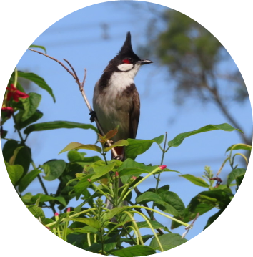
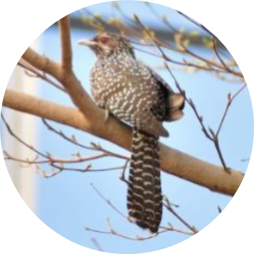
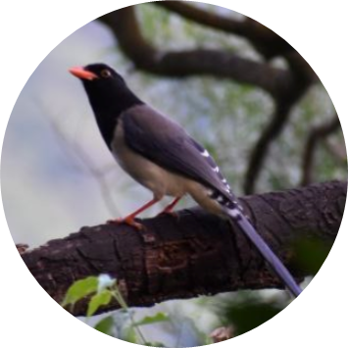

Which of the following is a common bird in urban areas of Hong Kong?
a. Red-eared bulbul
ｂ. Common koel
c. Red-billed blue magpie
d. All of the above

Slide 42
Which of the following is a common bird in urban areas of Hong Kong?
a. Red-eared bulbul
ｂ. Common koel
c. Red-billed blue magpie
d. All of the above

Slide 43

What are the potential health effects after exposure to high levels of indoor air pollutants?
a. Asthma
b. Headache
c. Sore throat
d. All of the above

Slide 44
What are the potential health effects after exposure to high levels of indoor air pollutants?
a. Asthma
b. Headache
c. Sore throat
d. All of the above

Slide 45
Instructions for Inspection,
Checklist and Monitoring

Slide 46
Instructions for Inspection
Evaluate the school’s environmental performance based on the Environmental Checklist:
  Regular Checks
  Surprise Checks
Environmental Checklist can be revised according to the school’s situations
  e.g. environmental facilities, no. of GPs and rosters
The editable version can be found in Schools Go Green website for school use
Ways for inspection are flexible!
  Frequency: at least once a month
  Format: Floor/Class/Environmental Aspect as a monitoring unit
  Division: Individual or in groups
Schools Go Green website

Slide 47
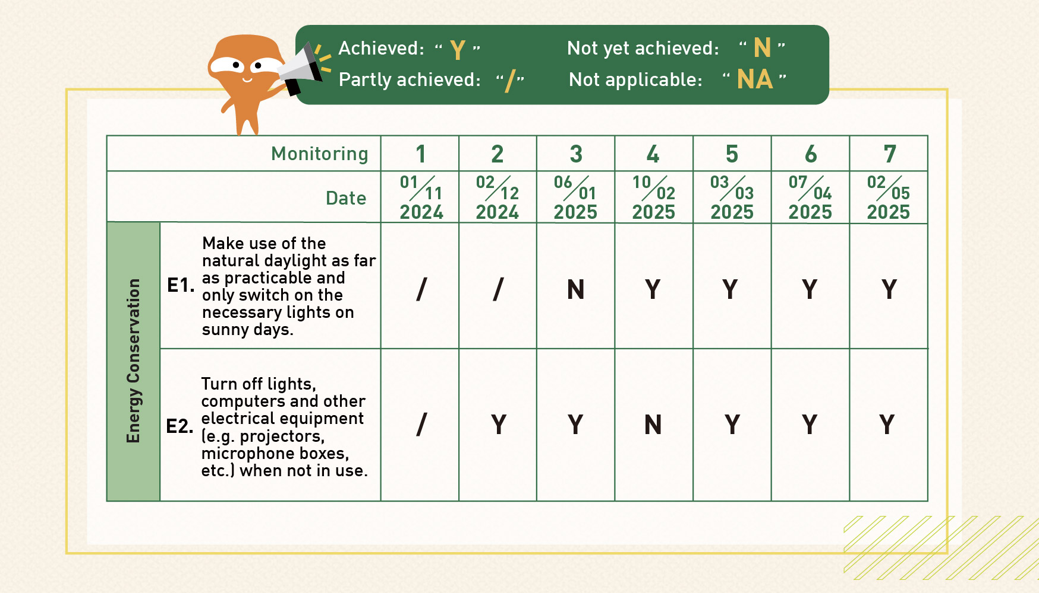
Instructions for Checklist
1. Input the date of checking
2. Fill in the status for
each item

Slide 48

Energy Conservation
E1. Make use of the natural daylight as far as practicable and only switch on the necessary lights on sunny days.
E2. Turn off lights, computers and other electrical equipment (e.g. projectors, microphone boxes, etc.) when not in use.
E3. Adopt natural ventilation (i.e. open windows and doors) and use fans to improve air flow when the outdoor temperature is below 25°C and the outdoor air quality is good.
E4. Maintain the temperature of air-conditioners in your classroom within the temperature range set under the school policy.
E5. When leaving the classroom, turn off fans and air conditioners that are not in use.

Slide 49
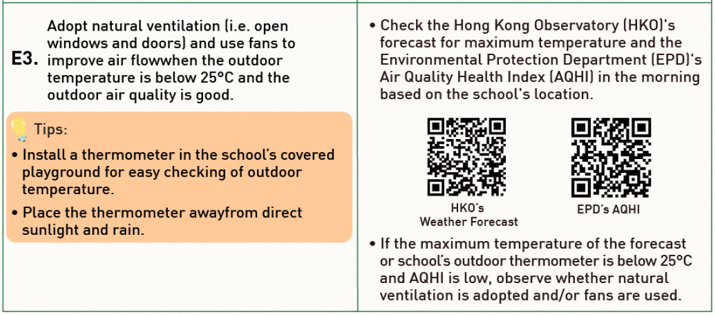
Energy Conservation

Slide 50
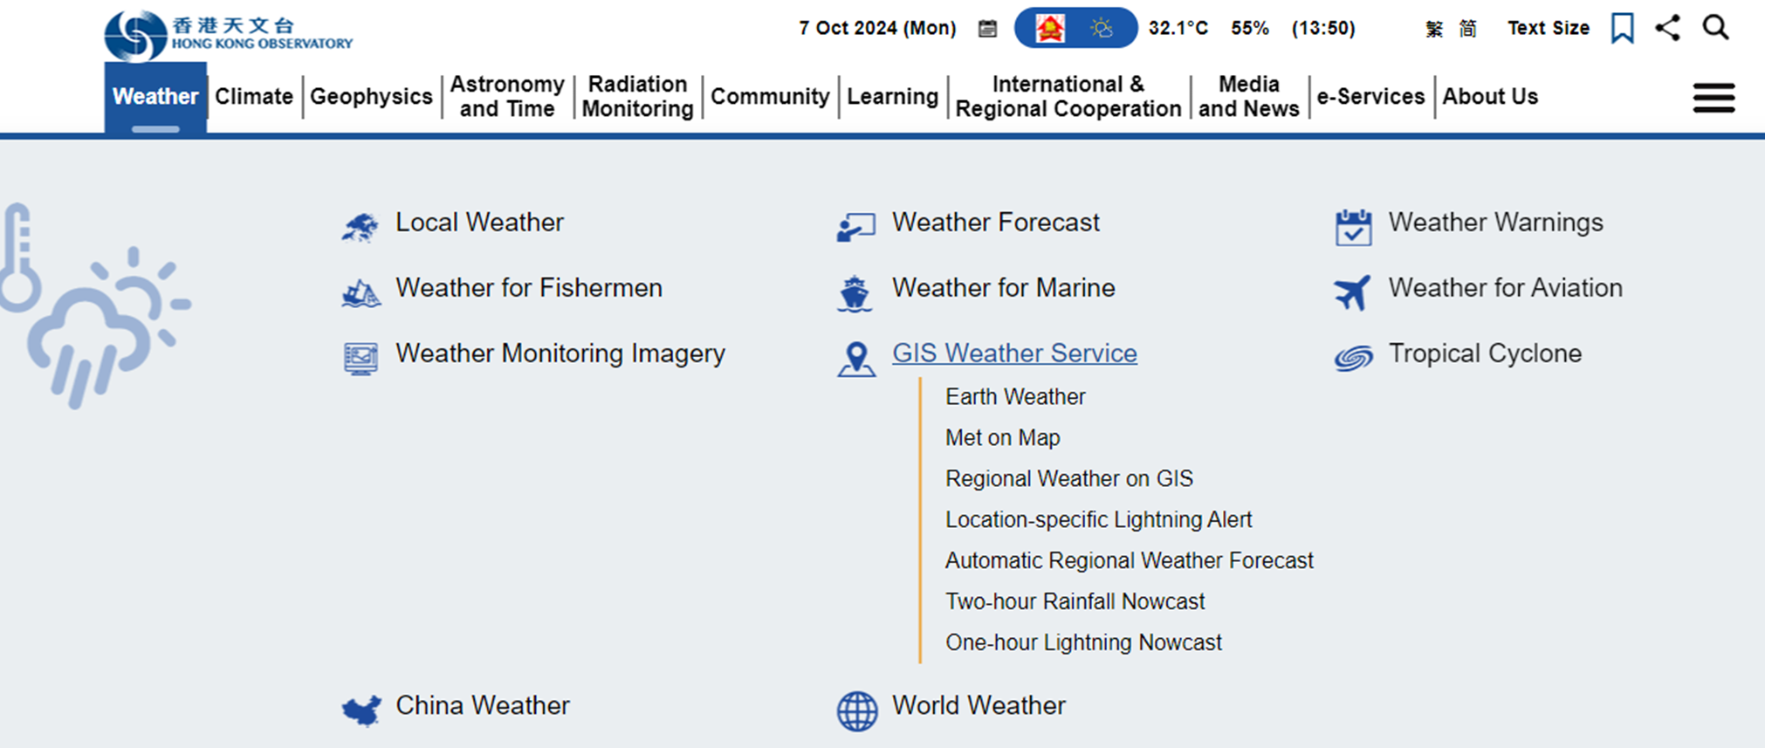
HKO’s Weather Forecast

Slide 51
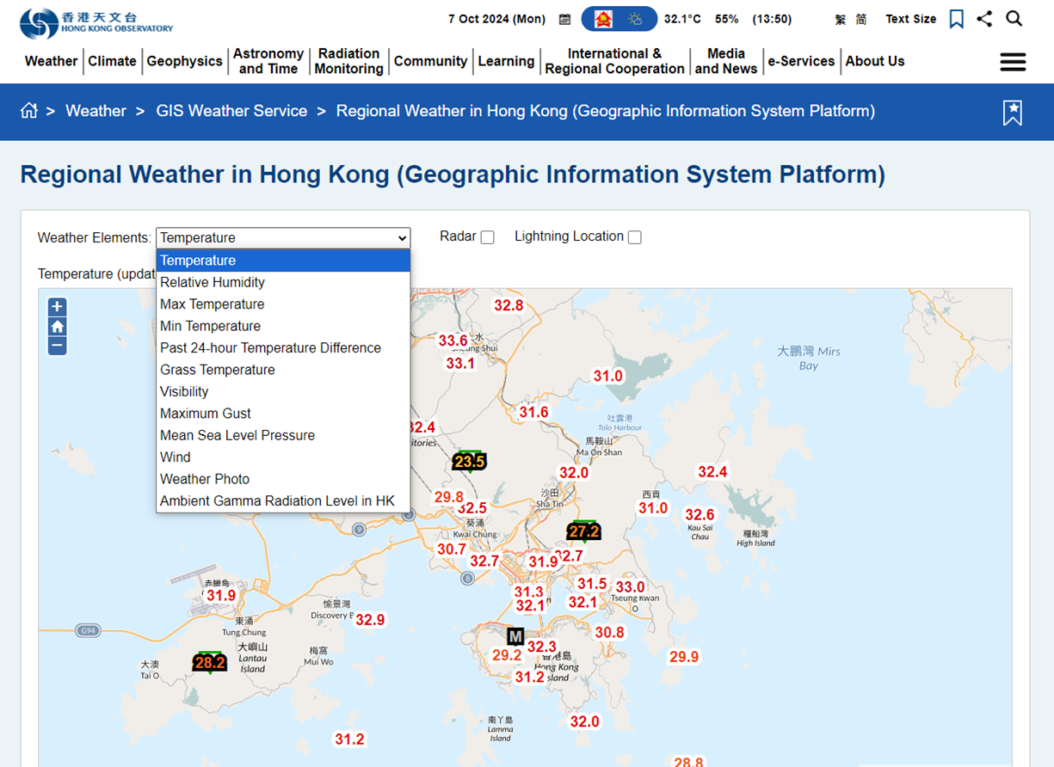
HKO’s Weather Forecast

Slide 52
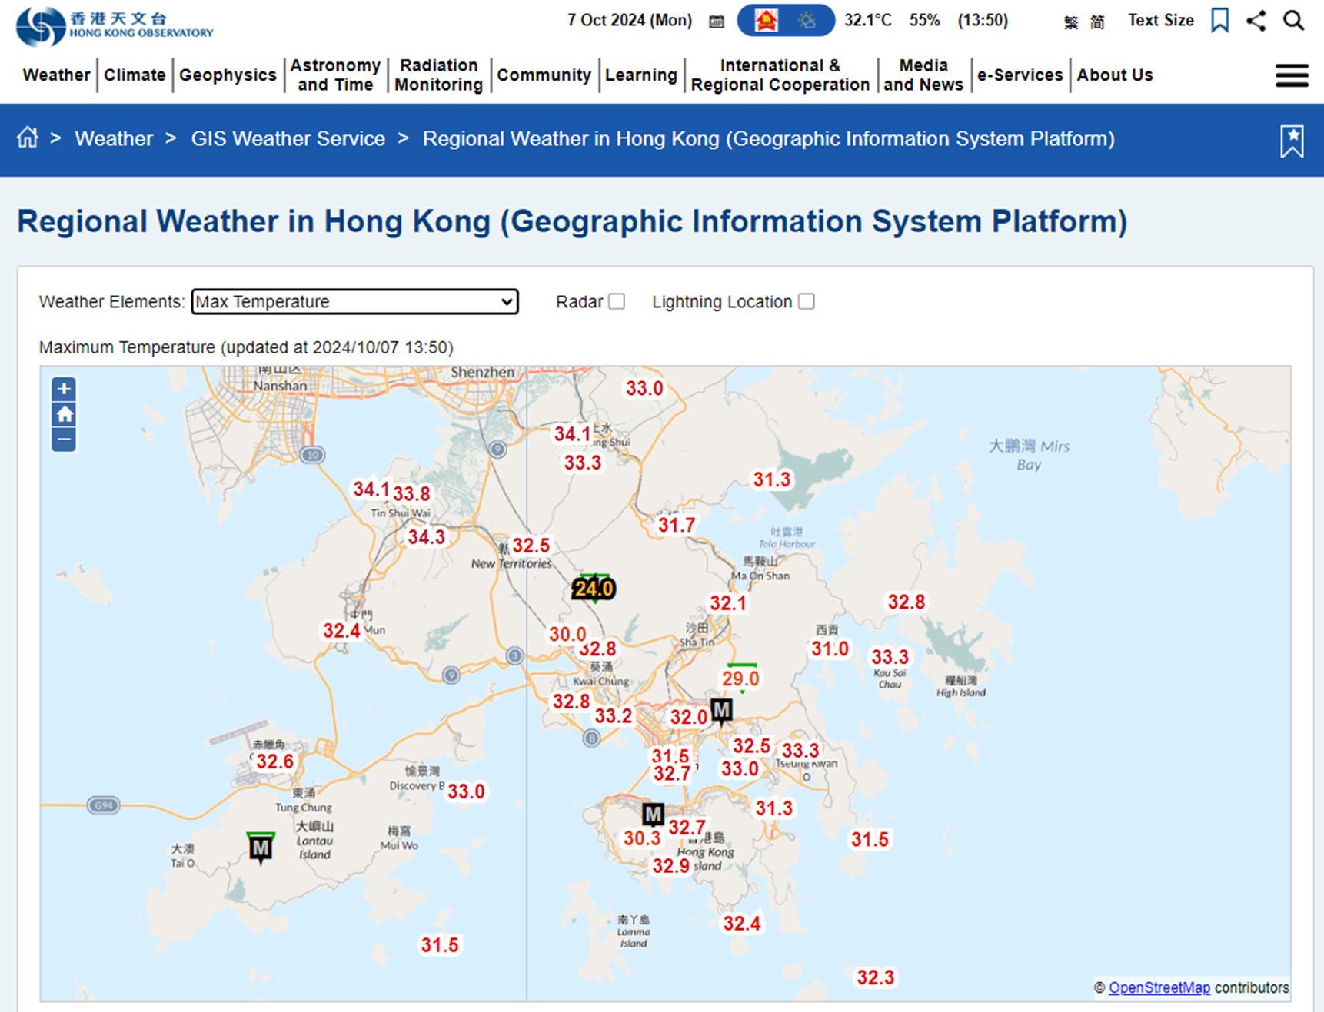
HKO’s Weather Forecast

Slide 53
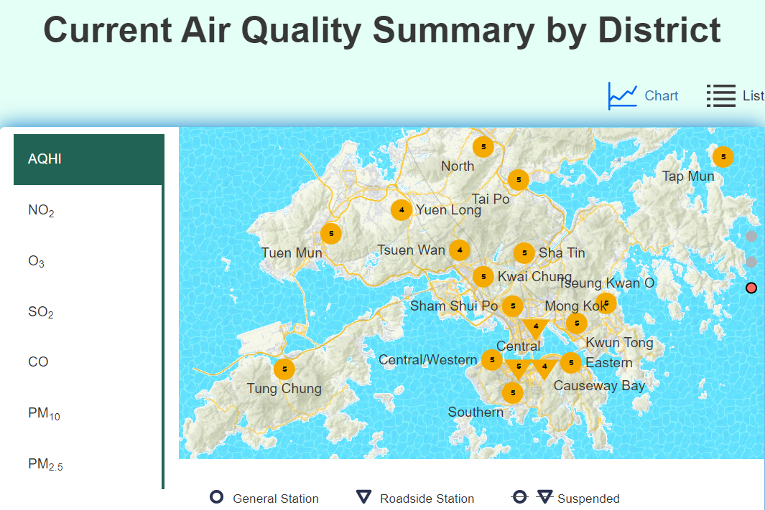
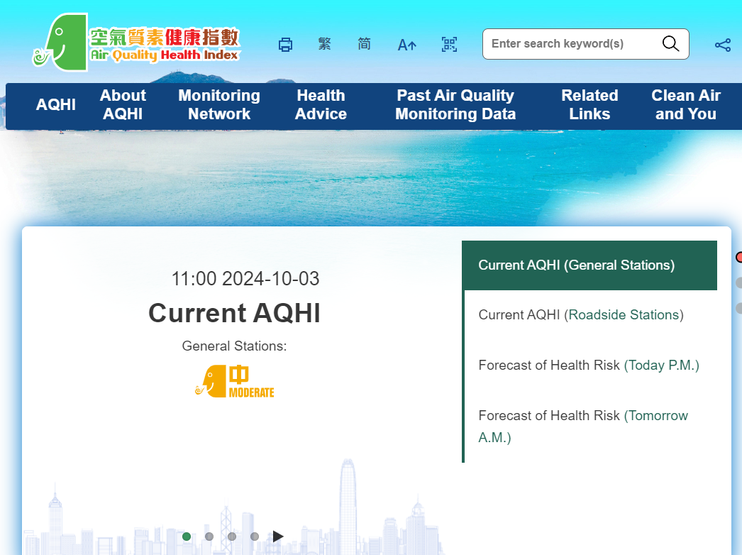
EPD’s AQHI
(Air Quality Health Index)

Slide 54

Water Conservation
W1. Turn off the water tap and/or drinking fountain after use.
W2. When soaping hands, turn off the water tap/move hands away from the tap (applicable to schools with infrared automatic sensing water taps installed).
W3. Do not overwater the plants (applicable to schools that have plotted plants in the classrooms or along the corridors).
W4. Check the water taps, water fountains and/or toilets regularly and report any leakages immediately, if any.

Slide 55

Waste Avoidance & Reduction
R1. Do not produce a significant quantity of leftovers.
R2. Separate the food waste from lunchboxes, cutlery and/or containers to facilitate food waste recycling, if any.
Paper
R3. Use handkerchiefs/towels instead of paper towels.
Food Waste
R4. Put one-side-used paper into the appropriate collection box.
R5. Use both sides of the paper and put double-side-used waste paper into the recycling bin.

Slide 56

Waste Avoidance & Reduction
R6. Bring your own water bottle.
R7. Stop buying bottled water and/or drinks.
R8. Drink without plastic straw or use reusable straws when necessary.
Plastics
R9. Use reusable meal boxes, cups, bowls and cutlery (such as spoons, forks, etc.) at school.

Slide 57

Waste Avoidance & Reduction
R10. Reuse folders.
R11. Use recyclables to make decorative items at school events (such as parties, sports days, picnics, outings, fun fairs, open days, etc.).
R12. Collect printer cartridges for recycling.
Reuse & Recycle
R13. Practise clean recycling.

Slide 58
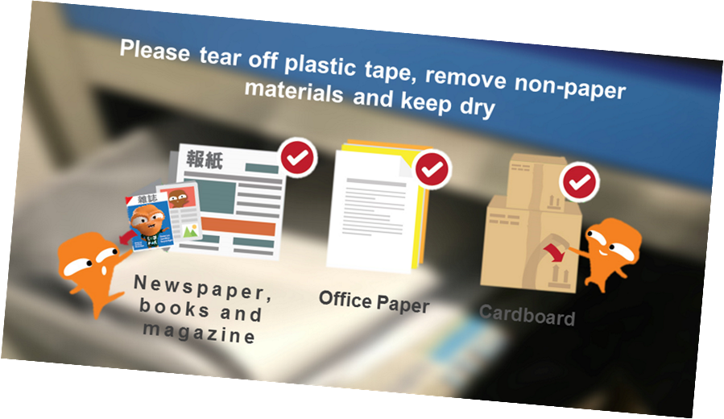
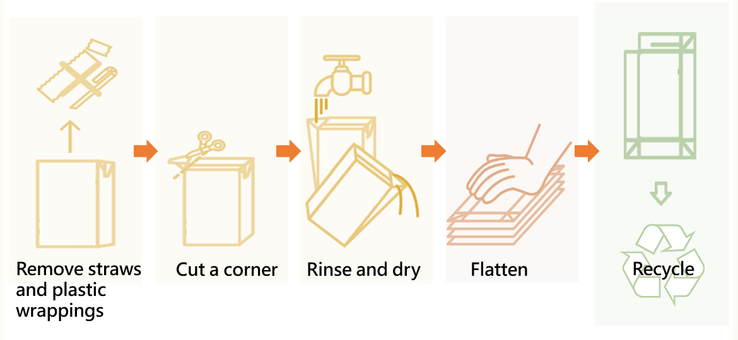
Waste Avoidance & Reduction
Reuse & Recycle
R13. Practise clean recycling.

Slide 59

Greening, Nature Conservation & Biodiversity
G1. Grow and look after plants in the classroom/along the corridor/green area/organic farm, if any.
G2. Use organic fertilisers (such as compost) as appropriate.

Slide 60

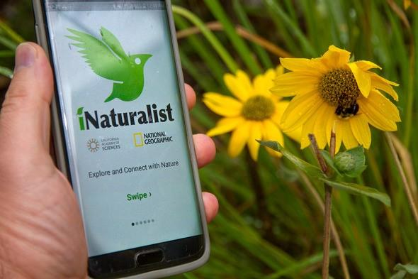
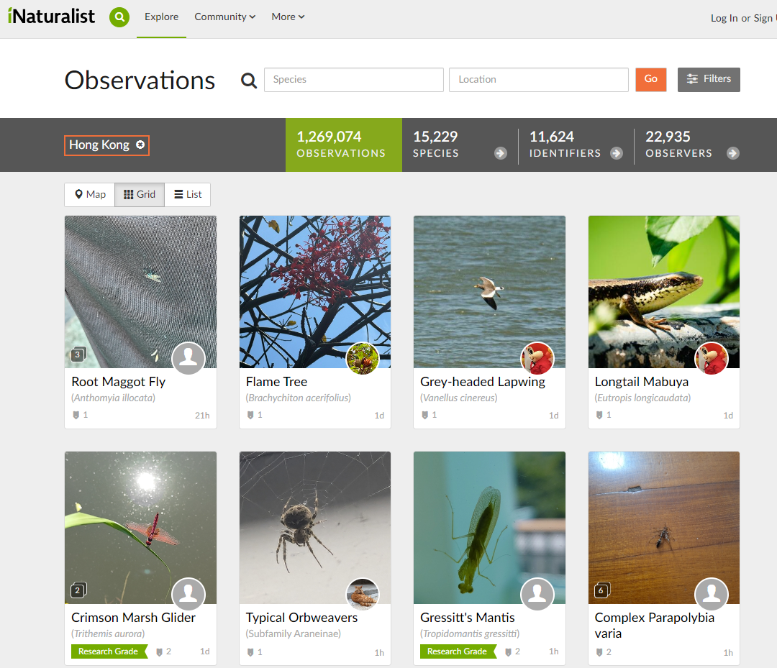
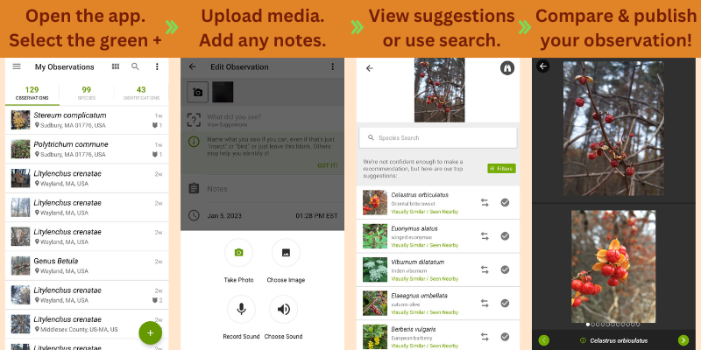
Greening, Nature Conservation & Biodiversity
G3. Record the diversity of flora and fauna (the number of species) on campus regularly.

Slide 61
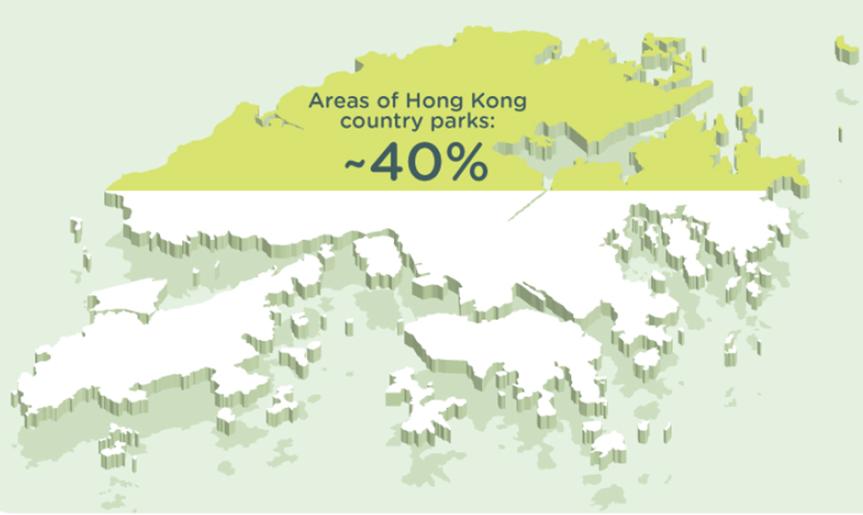

Greening, Nature Conservation & Biodiversity
G4. Practise “Leave No Trace” during school outings (e.g. school picnics, visits to country parks/geoparks, etc.).

Slide 62

Clean Indoor Air
A1. Keep the rubbish bin in the classroom clean and covered with a lid properly after use.
A2. Keep the food waste collection bins and/or composters on campus clean and ensure the lids are tightly closed after use, if any.
A3. Keep the seats and classroom clean and free of dust.
A4. Clean up food or drink spills immediately to prevent mould or bacterial growth, if any.
A5. Do not use stationery containing high level of volatile organic compounds (VOCs), such as marker pens, in the classroom.
A6. Timely activate the air purifier in the classroom, if any.

Slide 63



DOs and DON’Ts in Monitoring
Green Behaviours
DO use positive reinforcement!
Acknowledge and reward individuals or groups who consistently demonstrate eco-friendly practices.
DON’T be too critical!
Harsh criticism of individuals who may not fully engage in green behaviours.
✓
✗

Slide 64
Recommendation for
Environmental Promotion Activities

Slide 65
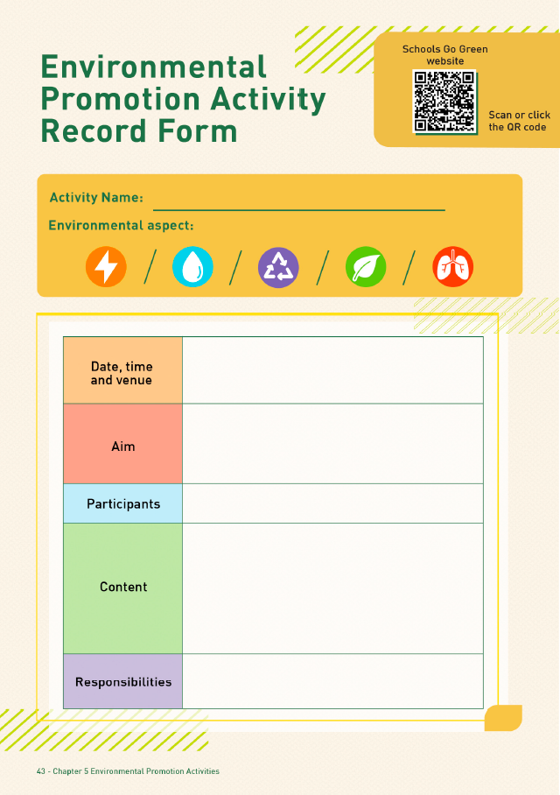
Recommendation for
Environmental Promotion Activities
Organise promotion activities for different aspects based on the school-based circumstances
  Aspects to be improved
  Students’ interested aspects
  Subject-related aspects
Factors to be considered:
  Activity date, time and venue?
  Activity’s objectives?
  How to recruit participant?
Join or communicate with external organisations for activity collaboration
Template for promotion activity
Downloadable from the Schools Go Green website

Slide 66
Overall Performance Evaluation

Slide 67
Overall Performance Evaluation
Conduct evaluations during the mid-term (around February) and at the end (around June) of the programme
Step 1:
Data Analysis
Step 2:
Group Evaluation
Step 4:
Setting New Goals
Step 3:
Result Announcement

Slide 68
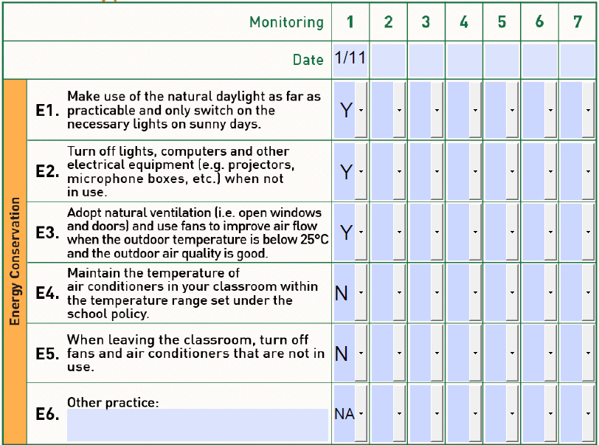
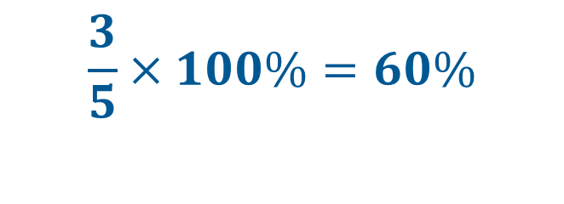
Overall Performance Evaluation
Step 1: Data Analysis
Collect and compile the Environmental Checklist Record Sheet
Conduct objective evaluation:
Total no. of elements = 5
No. of achieved elements = 3
Aspect’s performance:
$$\frac{3}{5}×100\%=60\%$$

Slide 69







Overall Performance Evaluation
Step 2: Group Evaluation
GP can hold a meeting to review the performance of the school
Evaluate the performance trends of different items
Figure out the highest / lowest rated aspects
Environmental Aspect | F1 | F2 | F3 | F4 | F5 | F6 | Average Score (%)
Energy Conservation | 60% | 80% | 60% | 80% | 80% | 70% | 71.7%
Water Conservation | 33% | 33% | 66% | 66% | 66% | 100% | 60.7%
Waste Avoidance & Reduction | 72.7% | 63.3% | 81.1% | 63.3% | 54.4% | 81.1% | 69.3%
Greening, Nature Conservation & Biodiversity | 50% | 50% | 75% | 75% | 75% | 100% | 70.8%
Clean Indoor Air | 50% | 50% | 100% | 50% | 100% | 50% | 66.7%
Highest
rated aspect
Lowest
rated aspect

Slide 70

Overall Performance Evaluation
Report the results to all students
Commend classes with excellent environmental performance
Share the results of the GP Programme with the school management
Step 3: Result Announcement

Slide 71
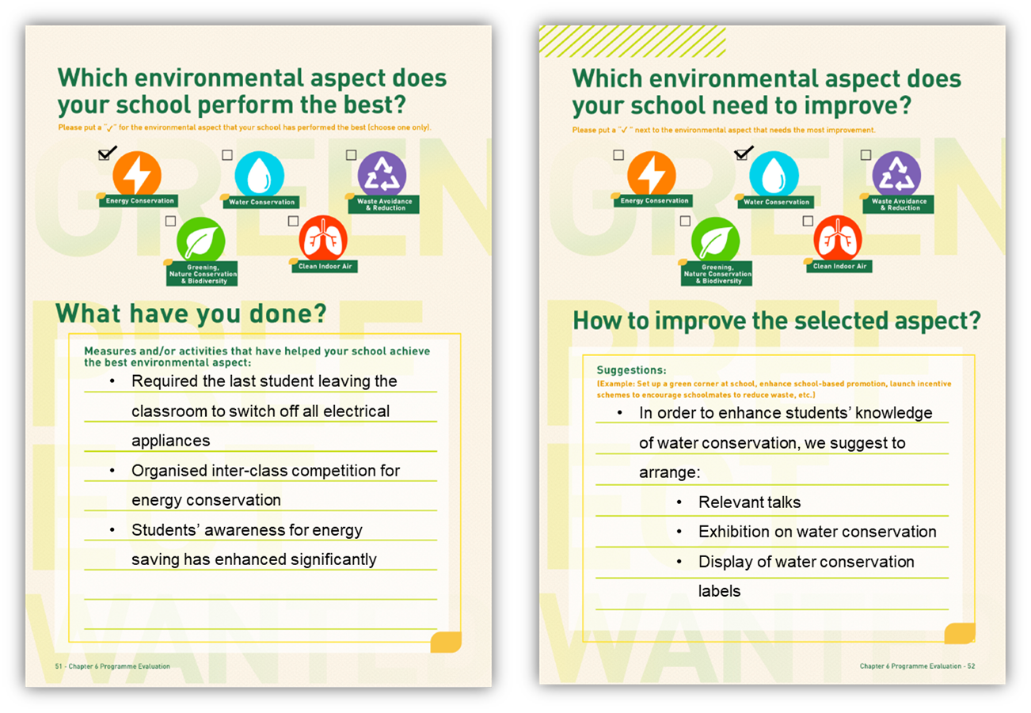

Overall Performance Evaluation
Step 4: Setting New Goals
  Look for the reasons and make improvements!
  At the end of each school term/school year:
    Propose feasible suggestions
    Set goals and plans for the coming school term/year

Slide 72
3. Quiz Time:
To Win Prizes!

Slide 73
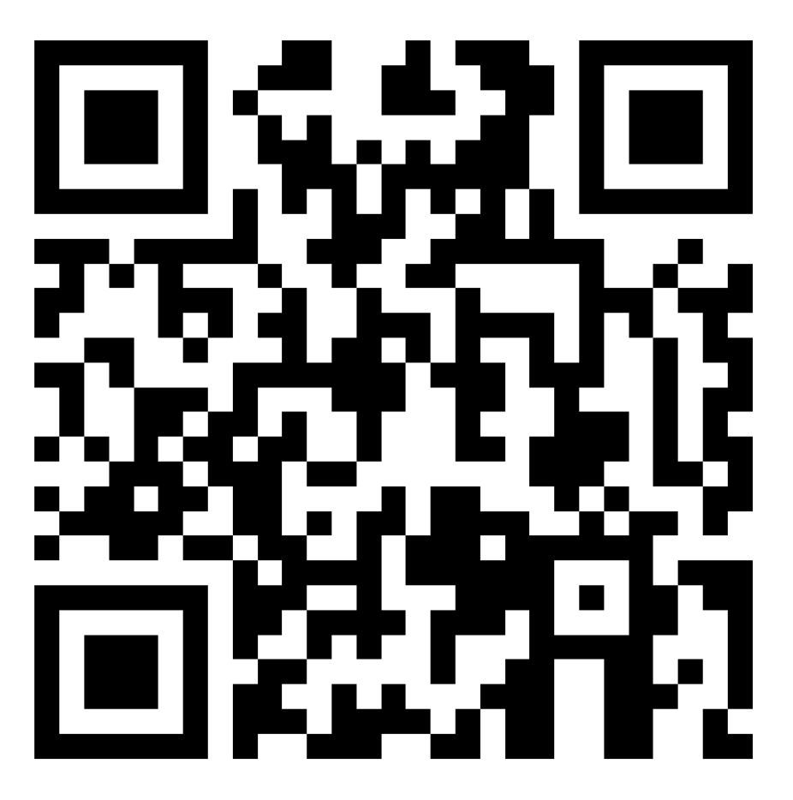
Quiz Time: To Win Prizes!
The top 3 students who scored the highest and submitted first (by the end of the online briefing session) will win the prizes!
Please scan the QR code to join the 3-minute quiz.
Prizes will only be given to students.
https://forms.office.com/r/sHagN3yCjv
Hints: Please make sure the school name and your name are correct.
The prizes will be delivered to the teacher advisor for passing to the
winner via mail.

Slide 74
Answers
What impact might climate change bring?
  a. Temperature rise
  b. Food shortages
  c. Economic losses
  d. All of the above
As of September 2024, what is the recorded concentration of carbon dioxide in the atmosphere?
  a. About 402 ppm
  b. About 412 ppm
  c. About 422 ppm
  d. About 442 ppm
Which of the following foods produces the most carbon dioxide emissions?
  a. Lettuce
  b. Lamb
  c. Beef
  d. Pork

Slide 75
Answers
Which of the following tasks is the responsibility of the GPs?
  a. Organising environmental activities
  b. Regularly monitoring students' environmental behaviors and the campus's environmental performance
  c. Encouraging students to establish green habits on campus
  d. All of the above
When you see a student throwing recyclable paper into the trash can, as a GP, what should you do?
  a. Blame them and report to the teacher
  b. Blame them and then guide them to place the paper, including staples, into the recycling bin
  c. Kindly guide the student to tear the paper into pieces before placing it into the recycling bin
  d. Kindly guide the student to remove the staples from the paper before placing it into the recycling bin

Slide 76
Answers
Which of the following environmental aspects are listed in the Green Prefect Programme Handbook?
  a. Energy Conservation; Water Conservation; Waste Avoidance & Reduction; Greening, Nature Conservation & biodiversity
  b. Energy Conservation; Ocean Protection; Waste Avoidance & Reduction; Greening, Nature Conservation & biodiversity
  c. Energy Conservation; Water Conservation; Waste Avoidance & Reduction; Greening, Nature Conservation & biodiversity; Clean Indoor Air
  d. Energy Conservation; Ocean Protection; Waste Avoidance & Reduction; Greening, Nature Conservation & biodiversity; Clean Indoor Air
What is biodiversity / species diversity?
  a. The number of animal/plant species
  b. The number of animals/plants
  c. The number of animals
  d. The number of plants

Slide 77
Answers
In front of you, there are 5 tree sparrows, 1 red-billed blue magpie, and 2 banyan trees. What is the number of species here?
  a. 2
  b. 3
  c. 6
  d. 8
What percentage of Hong Kong's total land area is designated as country park?
  a. 20%
  b. 30%
  c. 40%
  d. 50%
Which of the following actions does not help maintain good indoor air quality?
  a. Keeping the lid of the food waste collection bin closed
  b. Using stationery with high volatile organic compounds
  c. Keeping the environment clean
  d. Timely operation of the air purifier

Slide 78
4. Expected Outcome

Slide 79
What is your expected outcome after participating in the GP Programme?
Any skills / knowledge you want to acquire?
Any targets? Anything you want to do to promote environmental protection / sustainable development?

Slide 80
5. Experience Sharing

Slide 81
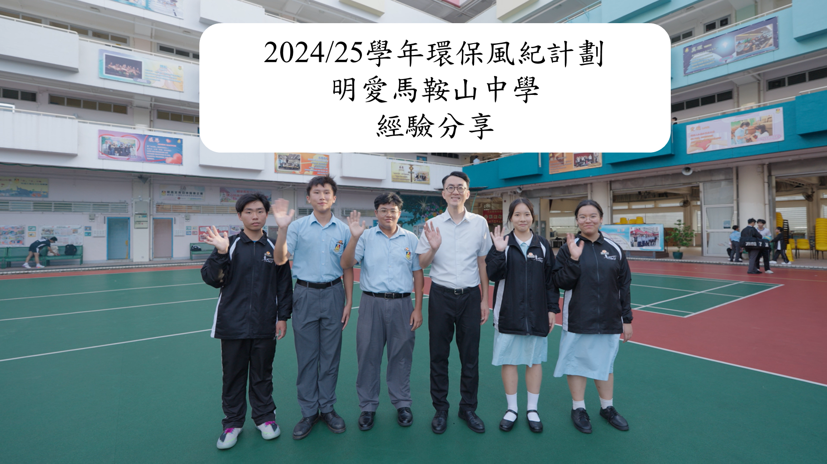
Past Participating School Sharing –
Caritas Ma On Shan Secondary School
(Cantonese version only with English subtitle)
https://youtu.be/v4ZmaC63I1U

Slide 82
6. Conclusion and
Q&A

Slide 83



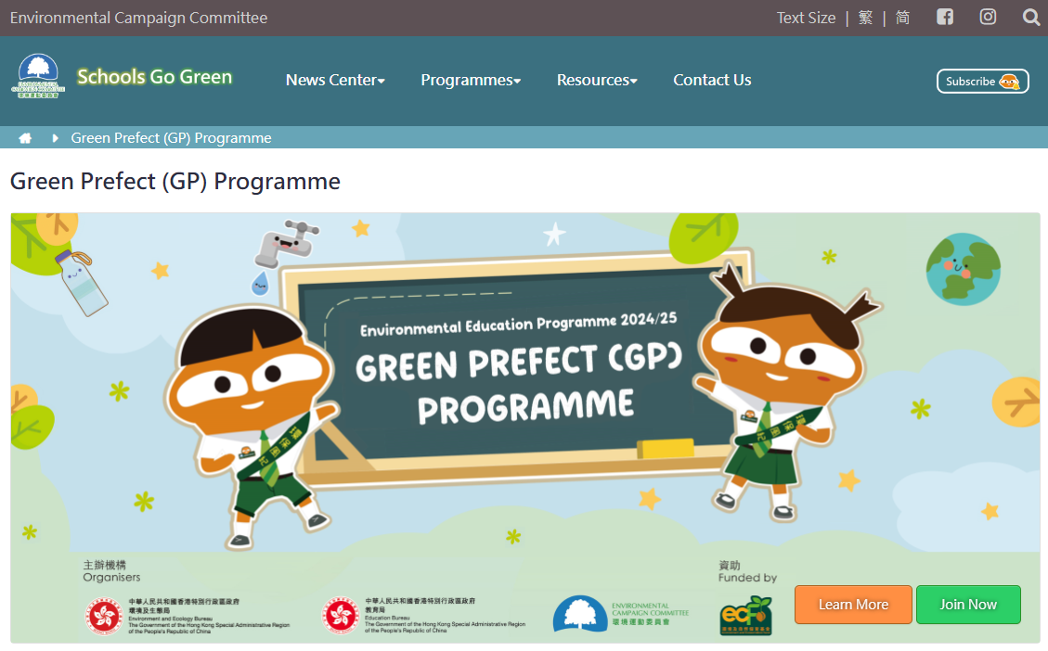
Programme Website
    GP Programme Website:
    https://school.ecc.org.hk/en/programmes/gpp.html
    Programme handbook and relevant materials, presentation slides, promotional video and materials, video highlights, experience sharing of past participating schools:
    https://school.ecc.org.hk/en/resources/forms.html#gpp

Slide 84


Programme Support
  Environmental Campaign Committee
    Telephone: 2835 1738
    Email: schools@eeb.gov.hk
    Fax: 2909 9516
  Technical Consultant
  Business Environment Council Limited
    Telephone / WhatsApp: 9301 0140
    Email: gp_hotline@bec.org.hk

Slide 85

Q&A Session

Slide 86
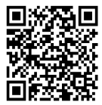
Questionnaire
Please scan the QR code or use link to join:
https://forms.office.com/r/t1KAaFreWt?origin=lprLink

Slide 87




Thank you for your support!

