Slide 1






















2025/26 學年環境教育項目
Environmental Education Programme 2025/26
環保風紀計劃
Green Prefect (GP) Programme
Training Workshop
(Secondary Session)
7/2/2026
查詢 Enquiry:
2272 0301
education.cahk@gmail.com
主辦機構
Organisers
資助
Funded By
技術顧問
Technical Consultant

Slide 2
Content
Goal: To help Green Prefects understand the concept of low carbon to get prepared for in-school promotion
Carbon Emissions & Carbon Neutrality
How to organise Environmental Promotion Activities?
Brainstorming Practice (1): Planning an Environmental Promotion Activity
How to design eye-catching posters?
Brainstorming Practice (2)：Designing Posters

Slide 3

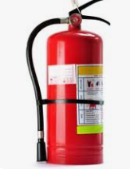
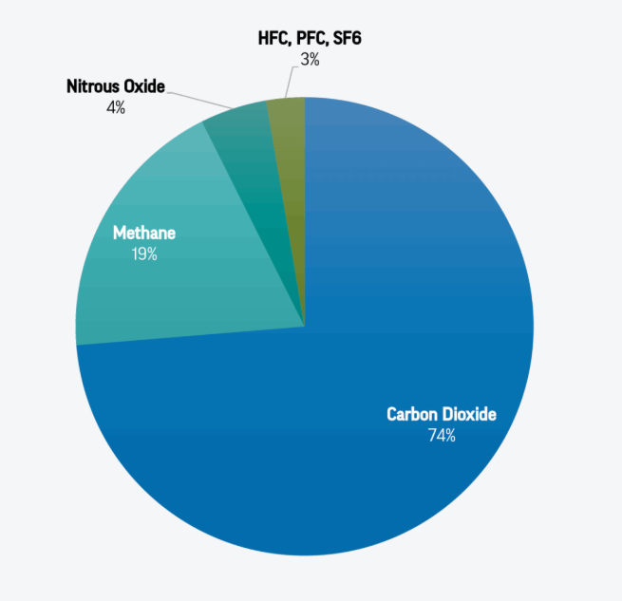
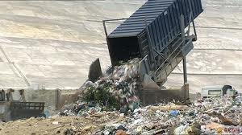
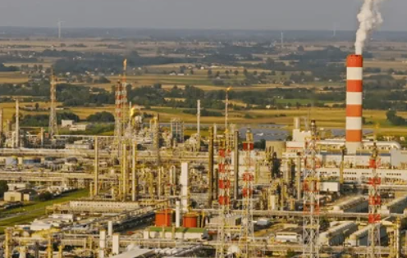
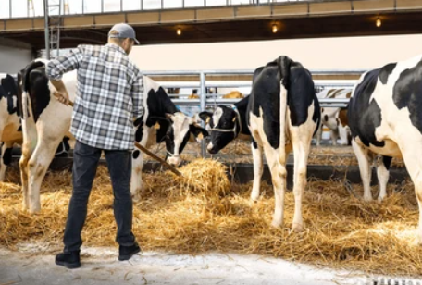
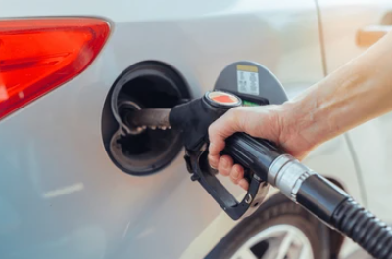
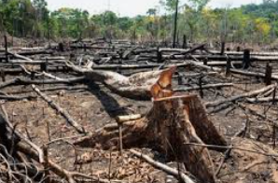
Global Human-made Greenhouse Gases Emissions (2023)
Methane (CH₄)
Hyrdroflurocarbons (HFC), Perflourocarbons (PFC),
Sulphur Hexafloride (SF₆)
Nitrous oxide (N₂O)
3%
4%
Carbon Dioxide (CO₂)
19%
74%
What do Carbon Emissions actually mean?
Info Source: Centre for Climate & Energy Solutions (2023)

Slide 4
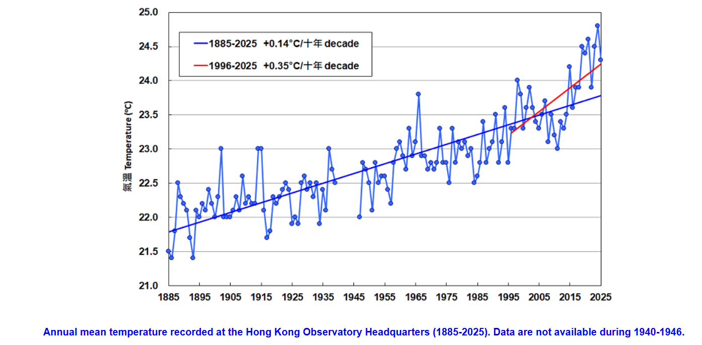
Change in Annual Average Temperature in Hong Kong
Calculation of annual average temperature:
Blue Line: Trendline of recorded temperature
Average temperature in HK is rising
What about the Red Line?
Sum of annual daily temperatures ÷ Total no. of days in that year
Temperature rose faster than expected after 1995
Info Source：The HK Observatory

Slide 5
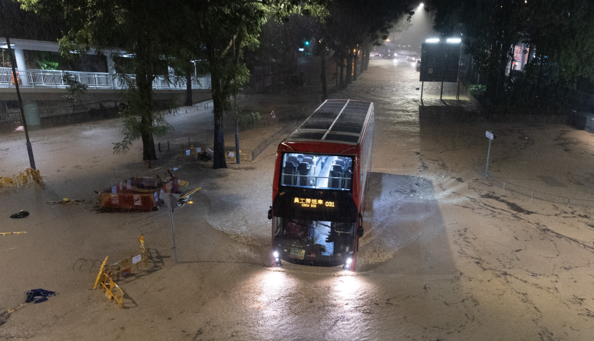
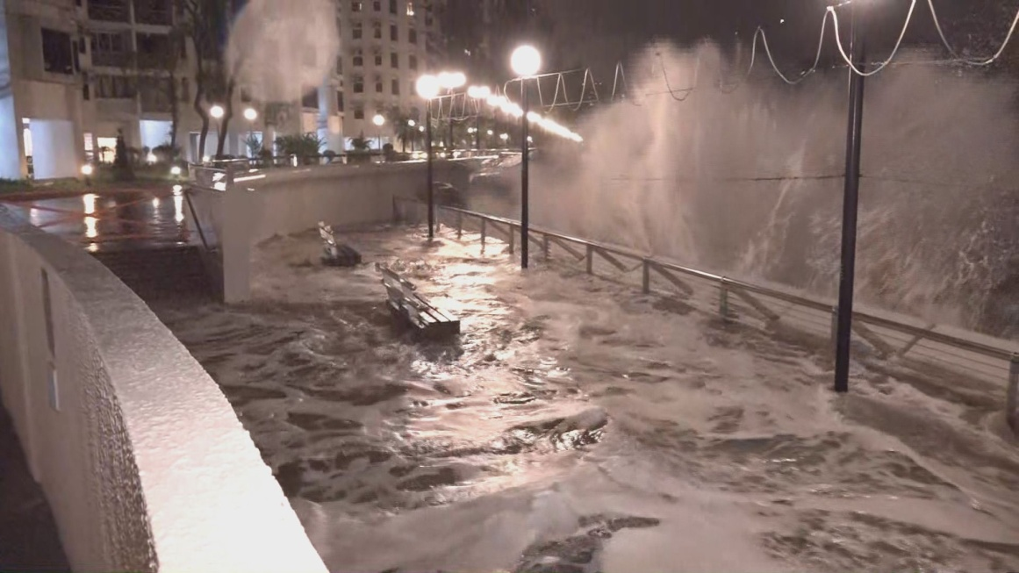
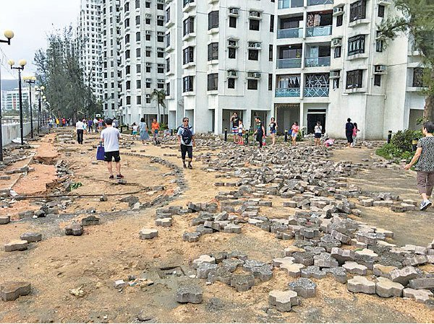
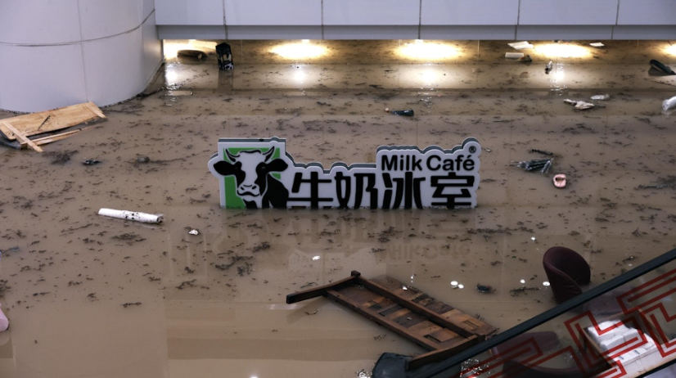
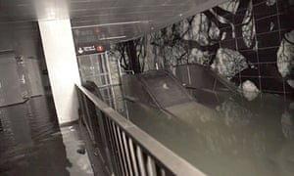
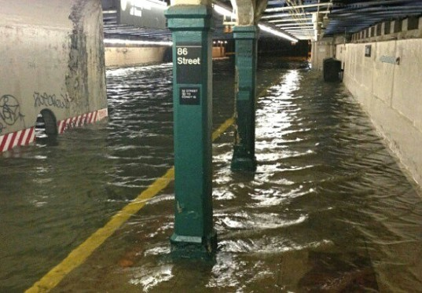
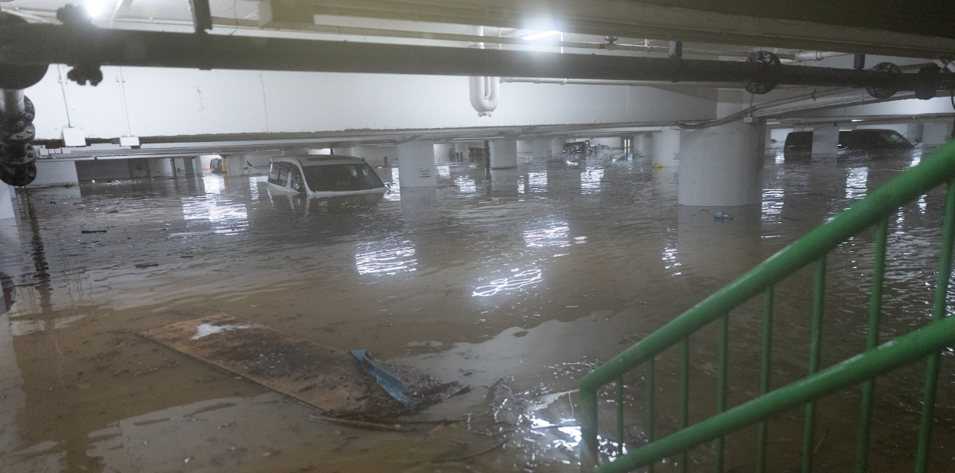
2023
2018
2012

Slide 6
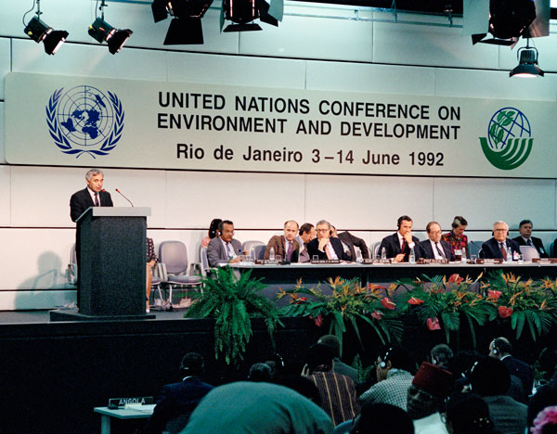
Conference of the Parties (COP)
Originated from Earth Summit (1992)
Supreme decision-making Body of the United Nations Framework Convention on Climate Change (UNFCCC)
State Parties discussing strategies to combat climate change together
In COP30 (2025)，194 State Parties participated, including:
  Brazil
  China
  Nigeria
  Indonesia
  Republic of the Congo
  France ……
1992 Earth Summit: "Acknowledging that change in the Earth's climate and its adverse effects are the common concern of humankind."
Info Source: Carbon Brief

Slide 7
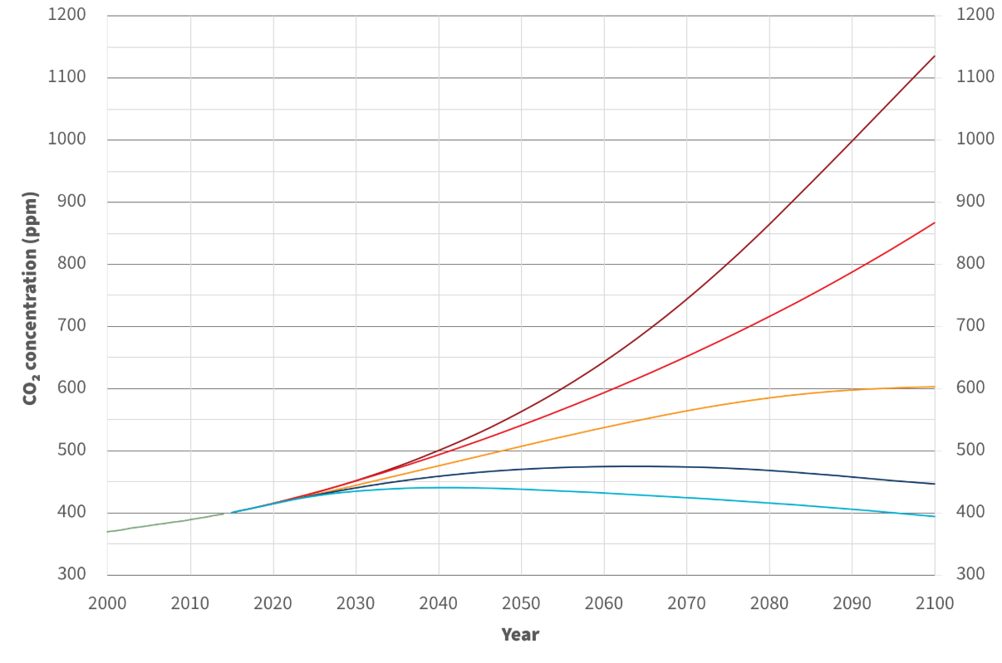
Conference of the Parties (COP)
SSP5：
Effective International Co-operation
High Economy
High Consumption
“Paris Agreement” (COP21): hold “the increase in the global average temperature to well below 2°C above pre-industrial levels” and pursue efforts “to limit the temperature increase to 1.5°C above pre-industrial levels”
“Glasgow Climate Pact” (COP26): Nations are called upon to phase down unabated coal power and inefficient subsidies for fossil fuels.
5 Shared Socioeconomic Pathways (SSP) proposed by the Intergovernmental Panel on Climate Change (IPCC)
5 possible directions of social development simulated by practical studies on basic and driving factors, e.g., world populations, human development, economy, lifestyle, policy and organisations, technology, the nature and natural resources, etc.
SSP5: Fossil-fueled Development
SSP1：
Effective International Co-operation
Focus on Sustainable Dev
Low Consumption
SSP4: Inequality
SSP3: Regional Rivalry
SSP2: Middle of the Road
SSP1: Sustainability
Info Source: Climatedata

Slide 8
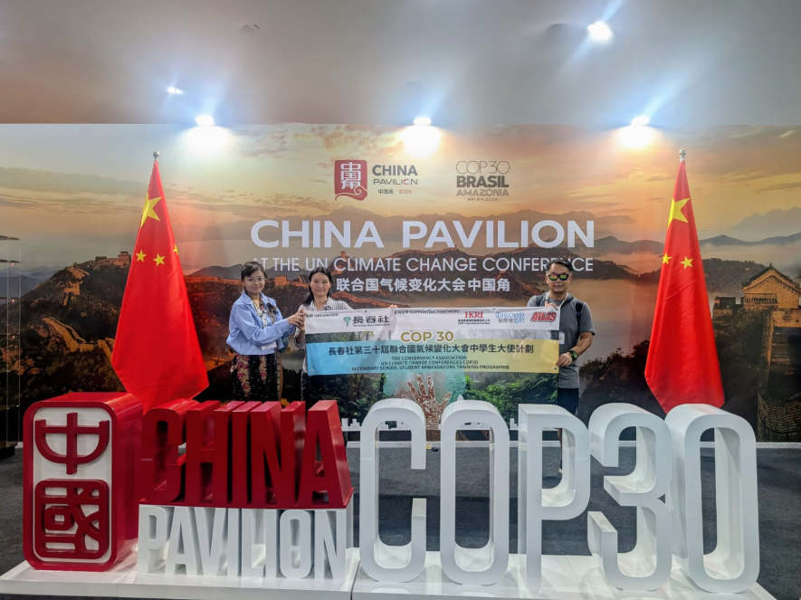
Some Important Conclusions of COP30 (2025)
Climate Finance
  Appeal to Developed Countries to mobilise US$1.3 trillion annually by 2035.
Nationally Determined Contributions (NDCs)
  NDCs need to be progressive and more ambitious than current NDCs.
Goals for Climate Mitigation
  Reaffirm the target of holding the increase in global average temperature to well below 2°C and limit to 1.5°C.
Tropical Rainforest Conservation
Call upon TRFs Conservation, with Tropical Forests Forever Facility, introducing an innovative incentive mechanism to achieve efficient forest compensation.
Info Source: United Nations; Fast Markets

Slide 9
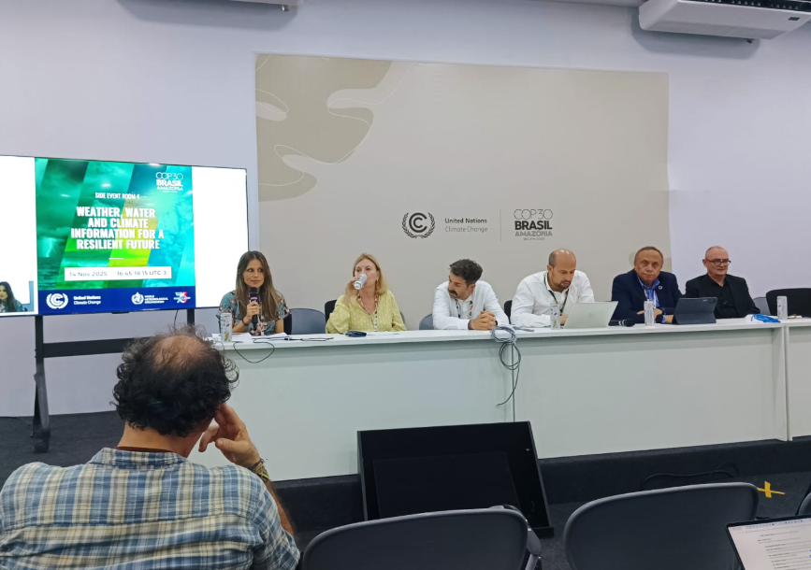
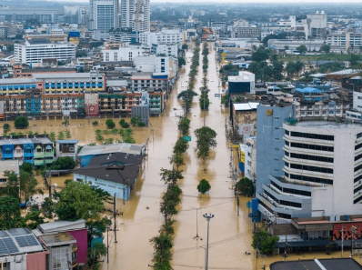
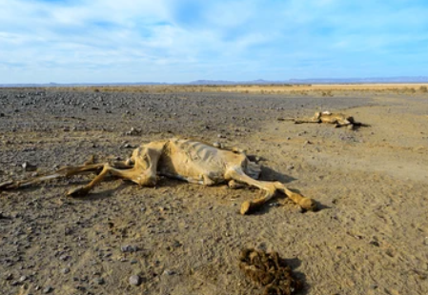
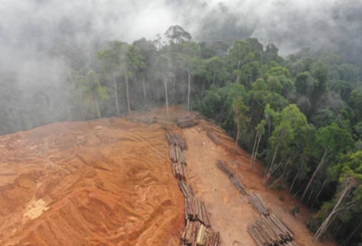
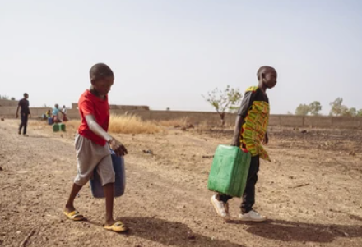
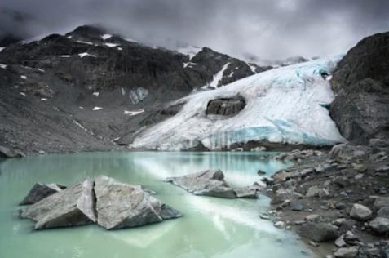
COP30 – Something Not yet Achieved
Phasing out Fossil Fuels
  Lacking of mandatory commitment and road maps on phasing out fossil fuels (although fossil fuels transitions was an agreement in COP28)
Anti-Deforestation
  Have not addressed commitments to stop deforestation
資料來源：Healthy Policy Watch; Carbon Brief

Slide 10

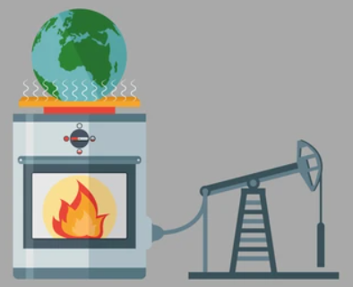








Carbon Neutrality
To reduce or offset the carbon emissions generated from own activities via various methods of carbon emission reduction
  Examples: Replacing conventional fossil energy, Conserving energy, Green commuting, “Use less, waste less”, Planting & Afforestation, Purchasing renewable energy certificates, carbon trading …
“Zero-carbon emissions”: Emissions equal to Removal
Info Source: ”Hong Kong's Climate Action Plan 2050”

Slide 11
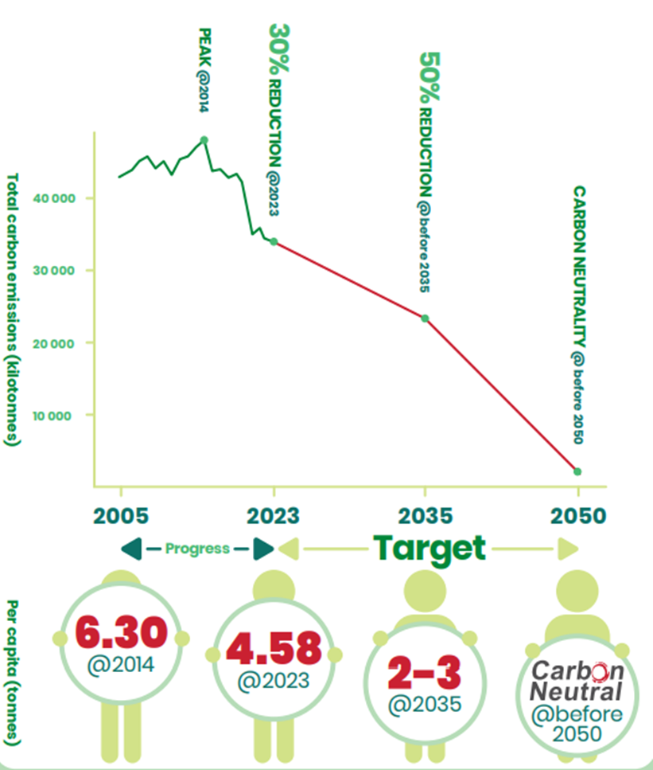
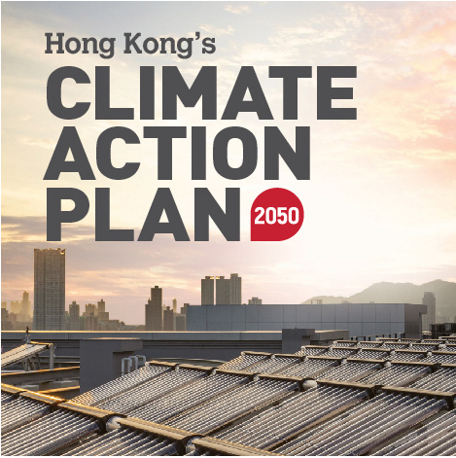
Total Carbon Emissions in Hong Kong
Peaked in 2014
Downward Trend is showing
Targets of “Hong Kong’s Climate Action Plan 2050”
  Before 2035: ⬇50%
  (Comparing to 2005)
  Before 2050: Achieving Carbon Neutrality
Info Source: ”Hong Kong's Climate Action Plan 2050”

Slide 12
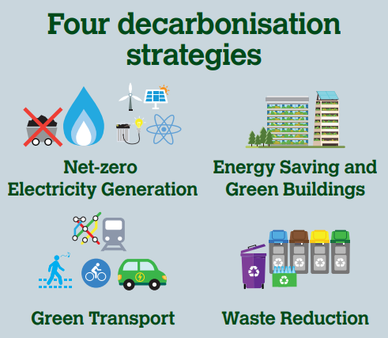
Could Hong Kong Achieve Carbon Neutrality?
Cease using coal for daily electricity generation
Increase the share of renewable energy in the fuel mix of electricity generation
Explore new technology of zero-carbon electricity
Promote green buildings
Enhance energy efficiency of existing buildings
Promote adoption of new energy transport
Attain zero vehicular emissions before 2050
Develop waste-to-energy facilities, move away from reliance on landfills
Promote waste reduction and recycling
Info Source: ”Hong Kong's Climate Action Plan 2050”

Slide 13


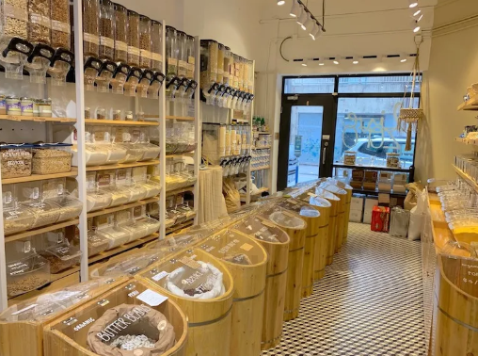
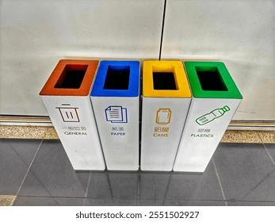

Low Carbon Living
Avoid/Minimise joining activities with high carbon emissions
Choose products/services with low carbon footprint
Avoid non-essential energy consumption

Slide 14
How to organise Environmental Promotion Activities?

Slide 15
Procedure for Organising Environmental Promotion Activity
Setting Theme & Goals of Activity
Reviewing Available Resources
Preparing Activity Proposal
Operation & Logistics Arrangement
Post-activity Evaluation

Slide 16

Setting Activity Goals
Are these goals easy/difficult?
What about these?
“No waste generated in the activity”
“To be the Best of Green Schools in Hong Kong”
“To have more people showing concerns towards environmental protection”
“To achieve 90%/100% recycling rate in the activity”
Feasibility?
“No disposable drinks container in X’mas party”
“To achieve that unused electrical appliances is 100% turned off after school”
“No recyclable waste in the rubbish bins of classroom”
“At least 50% of schoolmates understand that what biodiversity is”
Feasibility? Ways to Ensure?
How many people?
How to Achieve?
Setting Theme & Goals
Preparing Activity
Proposal
Operation & Logistics
Post-activity Evaluation
Reviewing Resources

Slide 17
Reviewing Available Resources
Resource Category | Example(s)
Venue/Space | Booths, Working Area, Materials Pick up Point, Flow of Participants…
Manpower | GPs? Other Schoolmates? Teachers? Parent Volunteers?
Fund | Chargeable? School Allowance? Cooperation with other parties (e.g., Student Union)?
Materials | Collection box? Tools for classification? Signage?...?
Setting Theme & Goals
Preparing Activity
Proposal
Operation & Logistics
Post-activity Evaluation
Reviewing Resources

Slide 18
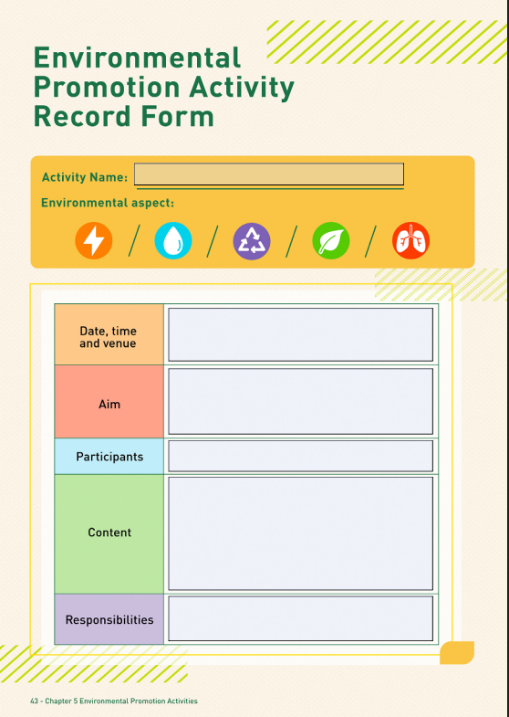
Preparing Activity Proposal
Activity Date(s) & Time
Activity Venue
Target Audience & Expected No. of Participants
Content of the Activity
  Ways of Promotion
  Event Content
  Potential Challenges & Solutions
  Post-activity follow-ups
Role & Duty of GPs
Setting Theme & Goals
Preparing Activity
Proposal
Operation & Logistics
Post-activity Evaluation
Reviewing Resources

Slide 19
Example: In-school Lunar New Year Fair
Aims | To minimise festival wastes To cultivate responsibility for environmental protection
Expected Outcomes / Targets | To reduce 10% of festival wastes through reduce, reuse & recycle
Date & Time | 13th Feb 2026 (CNY Activity Day)
Venue | School Hall / Covered Playground
Target Audience & No. of Participants | All students & teaching staffs (900 people)
Setting Theme & Goals
Preparing Activity
Proposal
Operation & Logistics
Post-activity Evaluation
Reviewing Resources

Slide 20
Example：In-school Lunar New Year Fair (Cont’d)
Key point: Consensus with stakeholders
Content of Activity | Before Activity Discussing recycling arrangement with teachers-in-charge and school Getting consensus about green measures with other booth operators, e.g.: Setting up recycling boxes in each booth Using gifts from other booths as prizes (also as a way to promote their booths) Promotion Allocating the work of GP Group Preparing materials During Activity Offering lucky draw for participants who bring along their recyclables Setting up games booth for promoting environmental messages After Activity Handling collected recyclables with school workers Sharing surplus materials with students, teachers or the needy in the community
Setting Theme & Goals
Preparing Activity
Proposal
Operation & Logistics
Post-activity Evaluation
Reviewing Resources

Slide 21
Example：In-school Lunar New Year Fair (Cont’d)
Potential Challenges | Solutions
Chaotic Situation | Adjusting the order of participants in participating different games Arranging GPs to maintain order
Recyclables Overload | Storing recyclables in a suitable space to avoid obstruction
Heavy Workload | Arranging more GPs to assist Recruiting other schoolmates as volunteers
Insufficient Clean Recycling | Providing Recycling Guidelines, with duty GPs to guide students Conducting inspection for clean recycling
Large Amount of Materials Remained after the Activity | Saving up for future use / community sharing Avoiding over-purchase by better estimation upon evaluations
Setting Theme & Goals
Preparing Activity
Proposal
Operation & Logistics
Post-activity Evaluation
Reviewing Resources

Slide 22
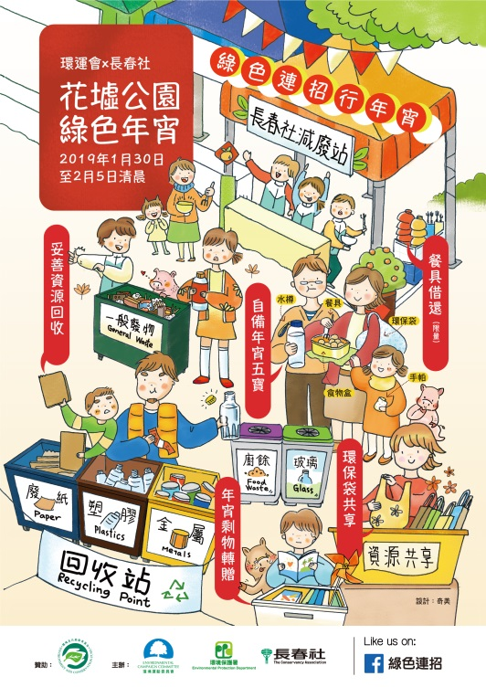
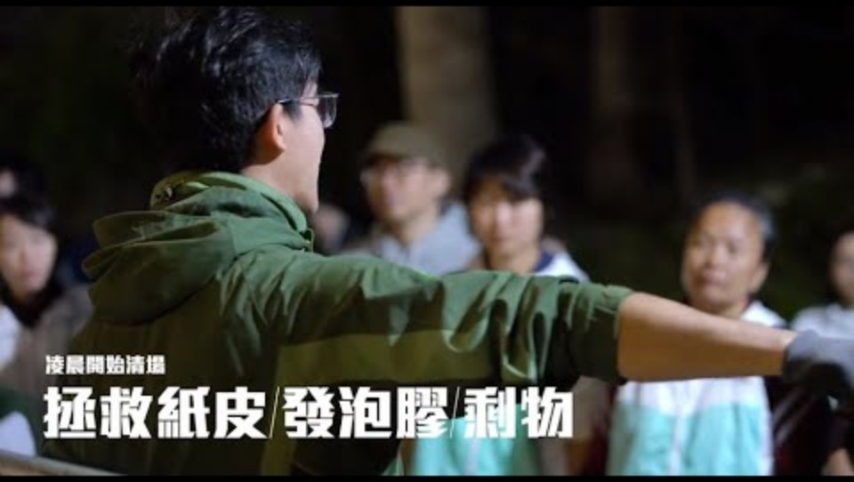
Real-life Example – Green Lunar New Year Fair@2019
https://www.youtube.com/watch?v=I-jscoHV_QA
Setting Theme & Goals
Preparing Activity
Proposal
Operation & Logistics
Post-activity Evaluation
Reviewing Resources

Slide 23
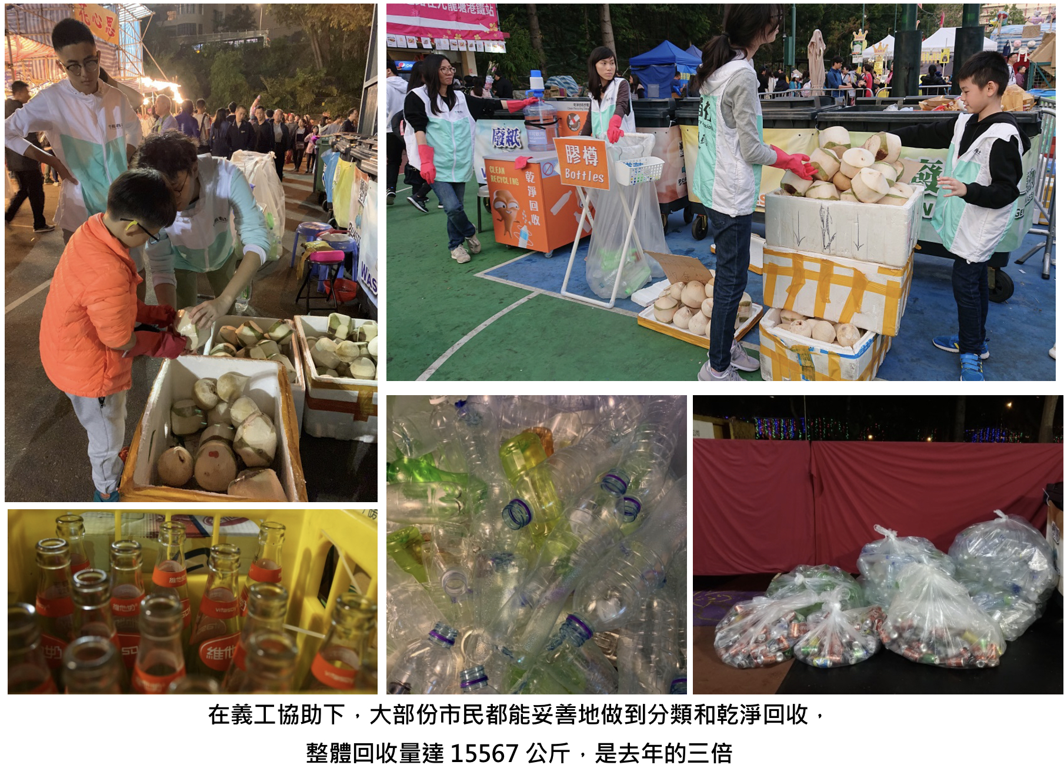
Real-life Example – Green Lunar New Year Fair@2019 (Cont’d)
Setting Theme & Goals
Preparing Activity
Proposal
Operation & Logistics
Post-activity Evaluation
Reviewing Resources

Slide 24
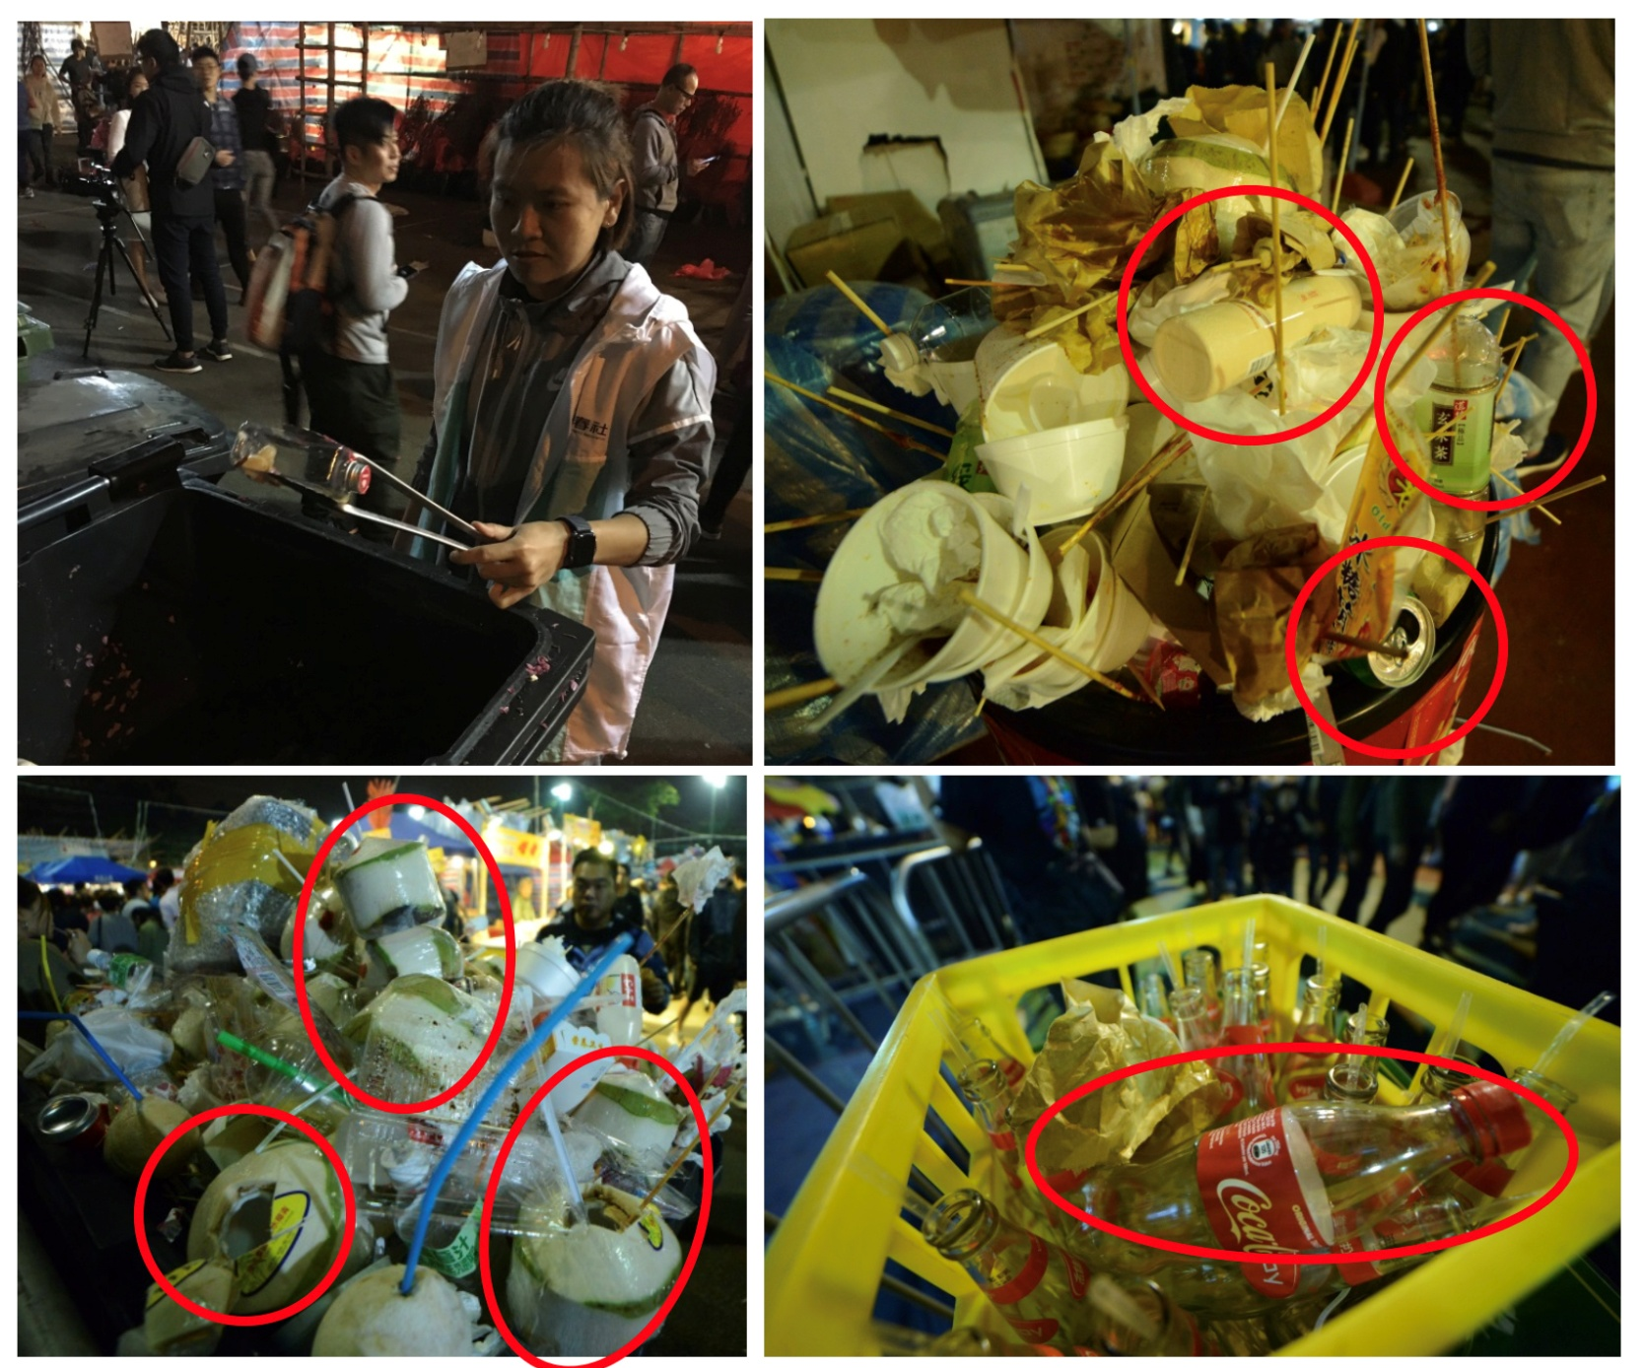
Real-life Example – Green Lunar New Year Fair@2019 (Cont’d)
Setting Theme & Goals
Preparing Activity
Proposal
Operation & Logistics
Post-activity Evaluation
Reviewing Resources

Slide 25
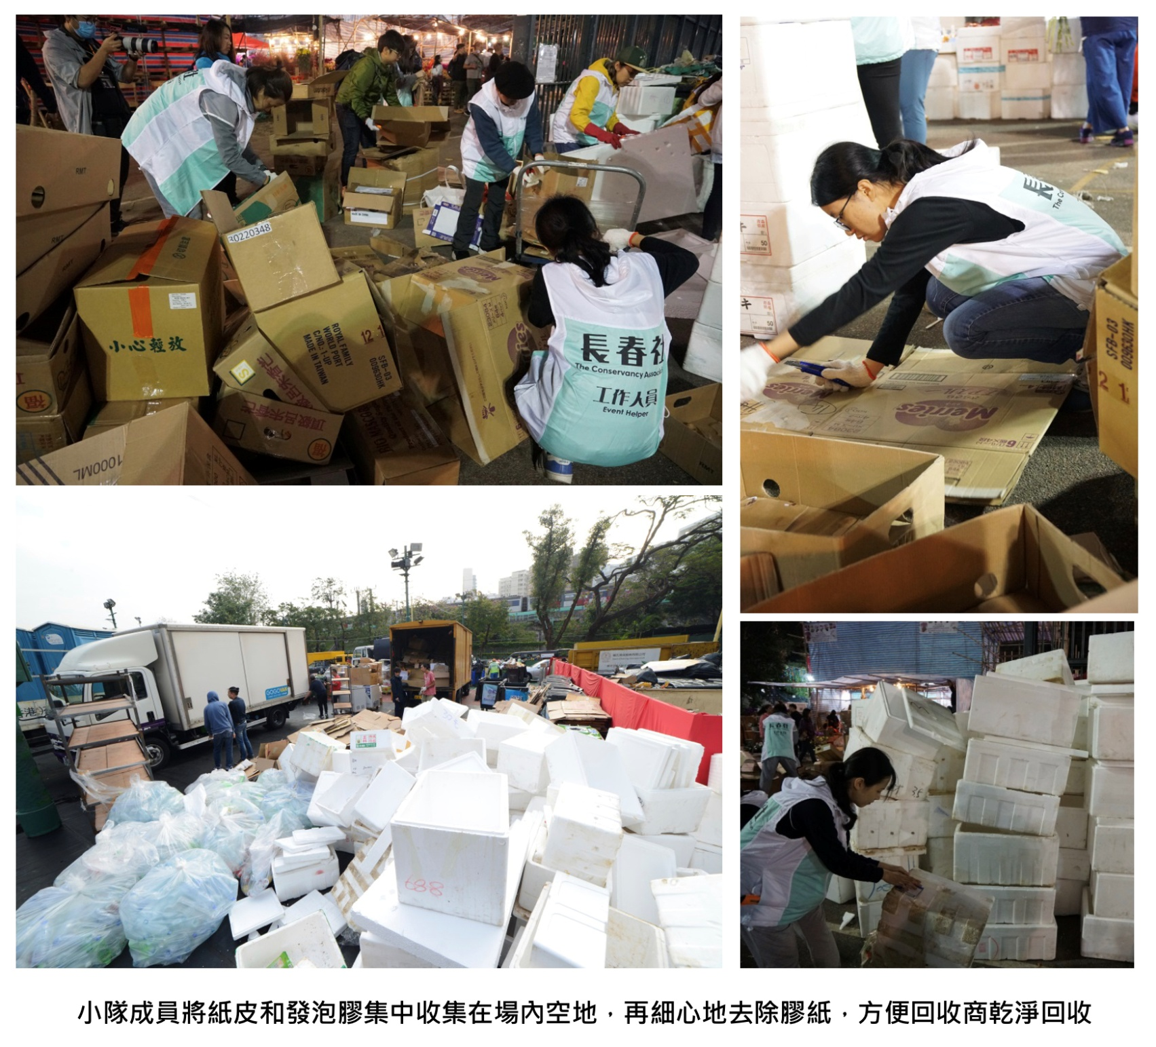
Real-life Example – Green Lunar New Year Fair@2019 (Cont’d)
Setting Theme & Goals
Preparing Activity
Proposal
Operation & Logistics
Post-activity Evaluation
Reviewing Resources

Slide 26
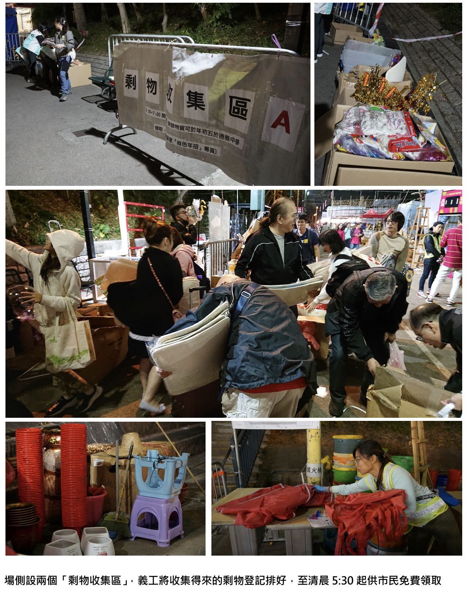
Real-life Example – Green Lunar New Year Fair@2019 (Cont’d)
Setting Theme & Goals
Preparing Activity
Proposal
Operation & Logistics
Post-activity Evaluation
Reviewing Resources

Slide 27
How to conduct evaluation?
Goal: To improve future work
Direct Behaviour Observation
Interview / Questionnaires
  Target audience
  Methods of collection
  How to ask?
    “Are you satisfied with the activity arrangement?”
    “Do you think this activity change your view towards environmental protection?”
    “Before this activity, how often did you practice such green measure?”
    “After this activity, how often would you practice such green measure?”
Setting Theme & Goals
Preparing Activity
Proposal
Operation & Logistics
Post-activity Evaluation
Reviewing Resources

Slide 28
Waste Management Strategy
Minimise
Reuse /
Replace
Recycle
3R Principle

Slide 29

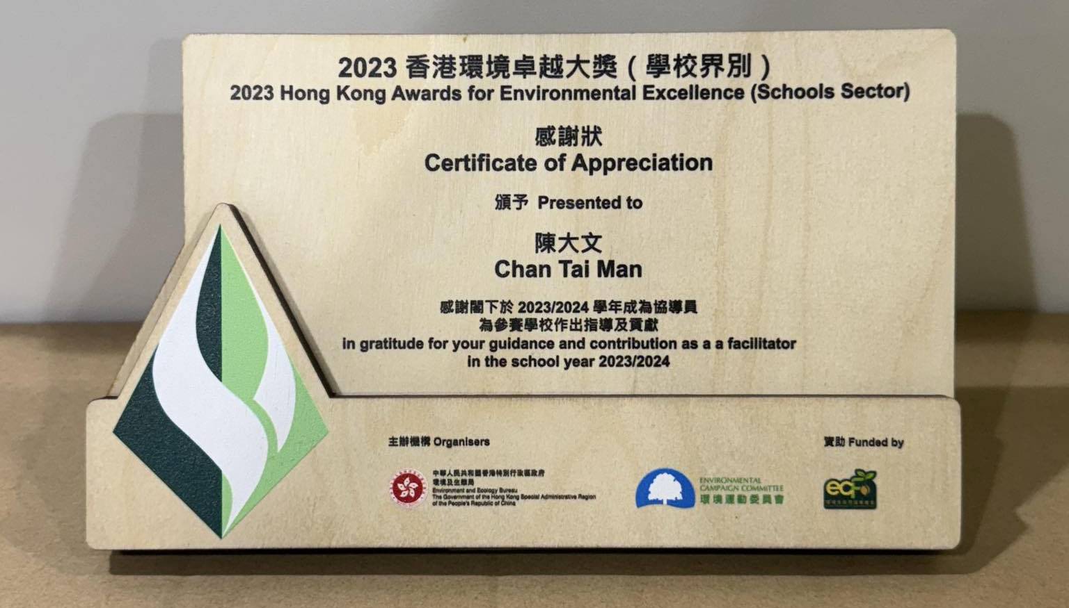


Printed Products
How to include more Green Elements in an activity?
100% Recycled paper
Forest Stewardship Council (FSC) Certification
Soy Ink Printing
Choose medals / trophies with recycling elements
Remember to show it on the products if qualified!

Slide 30

How to include more Green Elements in an activity? (Cont’d)
Admin, Promotion, Enrolment & Admission
Promotion Posters (Printed copy? Electronic?)
Promotion Banner (Printed copy? Electronic?)
Registration Procedures (Printed form? Online form?)
Admission Ticket (Printed? Electronic? Confirmation email?)

Slide 31
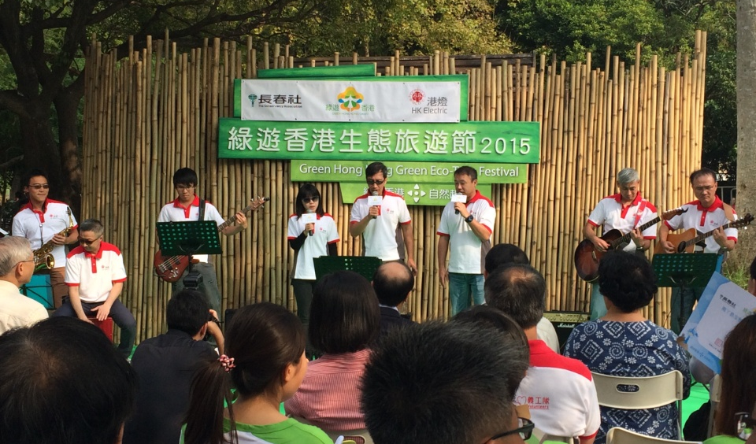
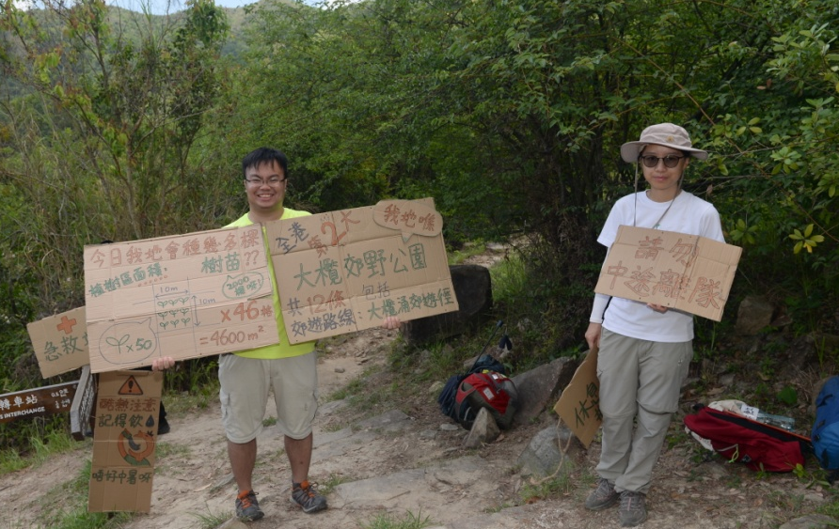
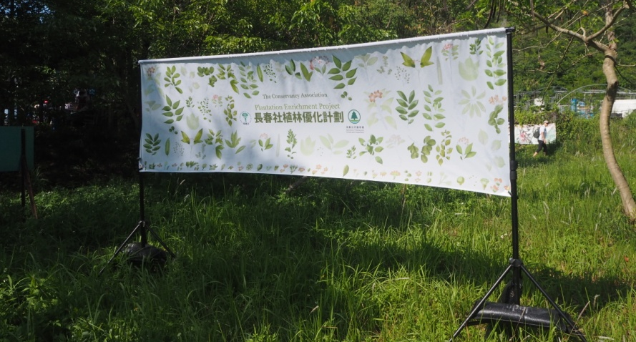
Venue Decorations
How to include more Green Elements in an activity? (Cont’d)
Backdrop (Reusable?)
Marquees, tables & chairs (Reusable?)
Booth Signs (Materials? Reusable? Recyclable?)
Signages (Materials? Reusable? Recyclable?)
Decorations (Materials? Reusable? Recyclable?)

Slide 32
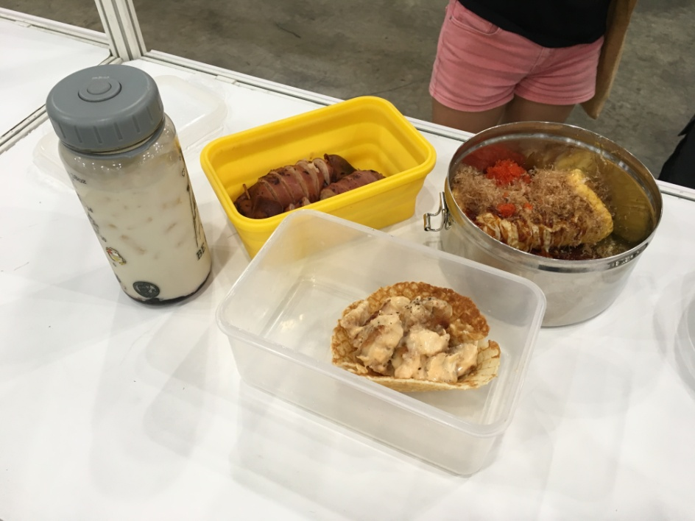
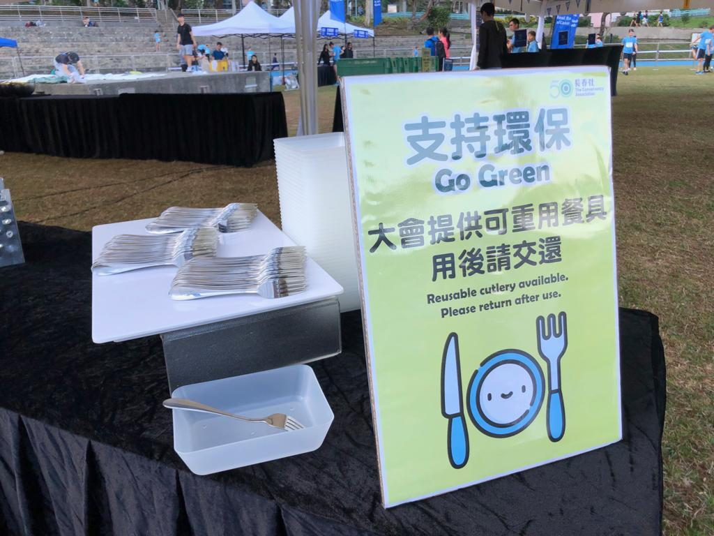
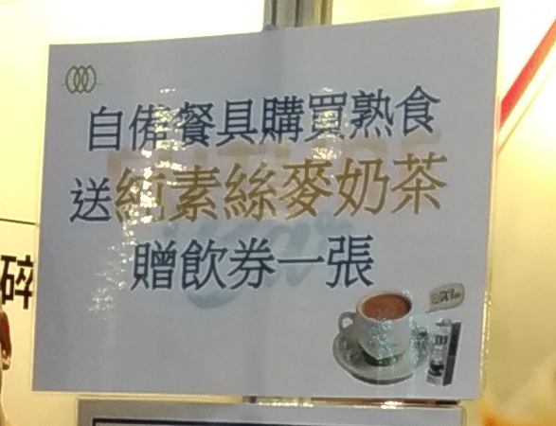
How to include more Green Elements in an activity? (Cont’d)
Incentives
Using Reusable Tableware
Free milk tea for who bring their own tableware

Slide 33

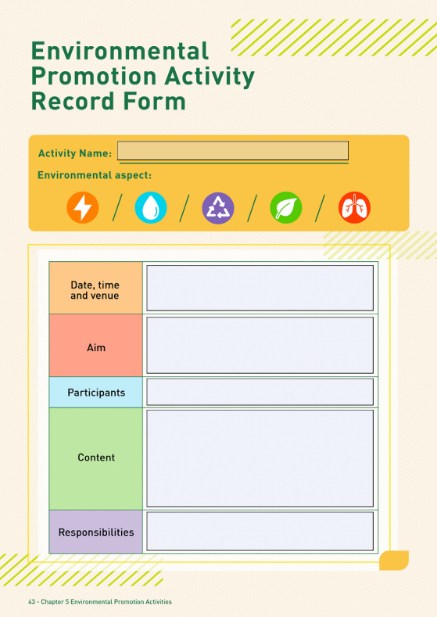
Brainstorming Practice (1): Planning an Environmental Promotion Activity
Task: Plan an environmental promotion activity and name it
Discussion Time: 20 mins
Objectives
Expected Outcomes / Goals
Venue
Resources needed
Potential Challenges and Solutions
Date & Time
Target
Activity Content / Rundown
Sharing Time: 3 mins / group
In-School Environmental Challenge
(1 / group)
Notes:
The 6 In-school Challenges:
1) The in-school recycling rate is far from satisfactory, with less than 30% of students having the recycling habit. Recyclables are often found in common trash bins.
2) Quite often, taps are kept flowing while students are soaping hands in washrooms. And much tissue paper is consumed upon hand washing, creating lots of paper wastes in trash bins.
3) Around 60% of students prefer take-away food during lunch time, creating lots of disposable container wastes. Certain students seldom finish all the food, leaving lots of left-over.
4) Plants inside the school garden are lack of variety, with 2 or 3 species (with relatively short flowering period) only. Also, students show little interest in the garden.
5) In summer, quite a number of students keep putting on sweaters, leading to low temperature setting of air-conditioners in classroom.
6) After school, lights and electrical devices in the classrooms are often left on, leaving the turn-off duty to school workers, thereby wasting energy.

Slide 34

Poster Example (1)
What are the messages?
  Updated Regulated Electrical Equipment (REE) Scheme
  Commencement Date
  Categories of REE
What elements remind you of environmental protection?
  Cartoon figures of electronics
  Poster colour tone
  Mascot of EPD – Big Waster
Info source：Environmental Protection Dept

Slide 35
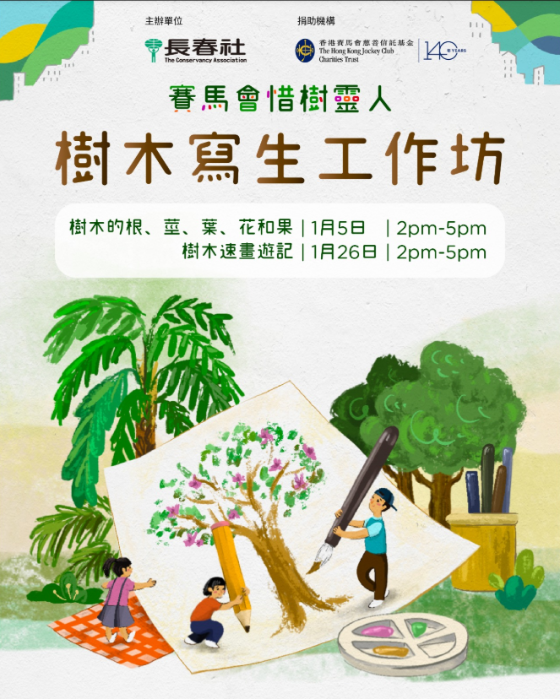
Poster Example (2)
What are the messages?
  Sketching Workshop
  Theme: Trees
Any nature-related elements?
  Colour tone(s)
  Trees & Flowers
Does the illustration match the theme?

Slide 36
Brainstorming Practice (2): Designing Posters
Task: Based on the Practice (1) discussed, create an e-poster for online promotion by using “CANVA”
Discussion Time: 15 mins
Sharing Time: 1 min / group

Slide 37
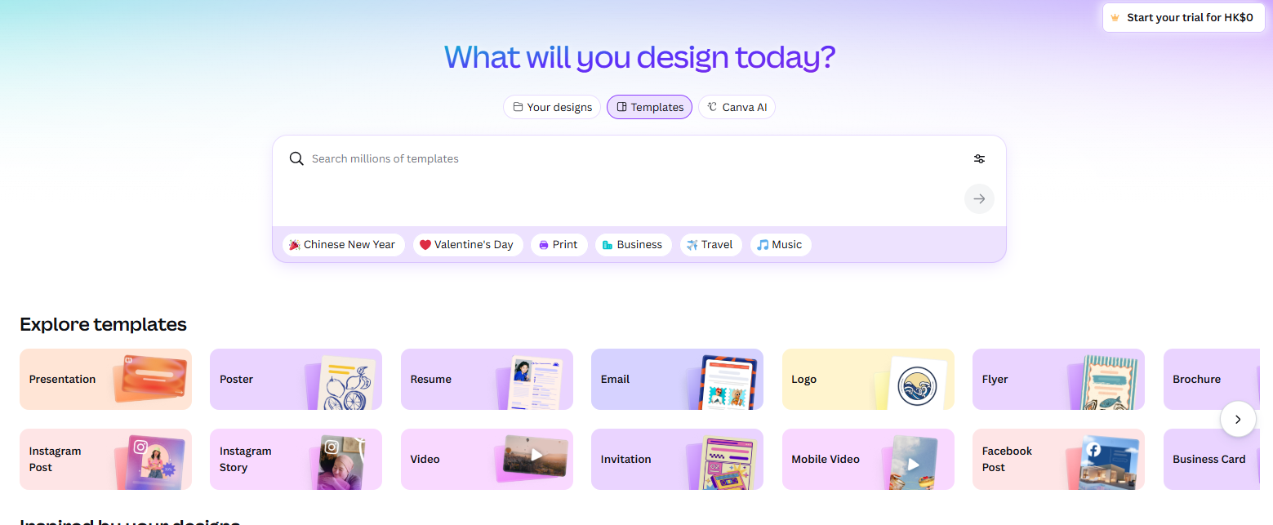
CANVA as a Tool (Basics)
Similar to POWERPOINT
“Poster” or “Leaflet” recommended

Slide 38

CANVA as a Tool (Basics)
Consider the content and nature of poster
You can design by yourself or use the template

Slide 39

CANVA as a Tool (Basics)
Different font size / positions for different parts of message
Moving the cursor to target spots
The tools column on the left have different design functions
Possible to upload pictures (download from online)
[beware of copyrights]

Slide 40
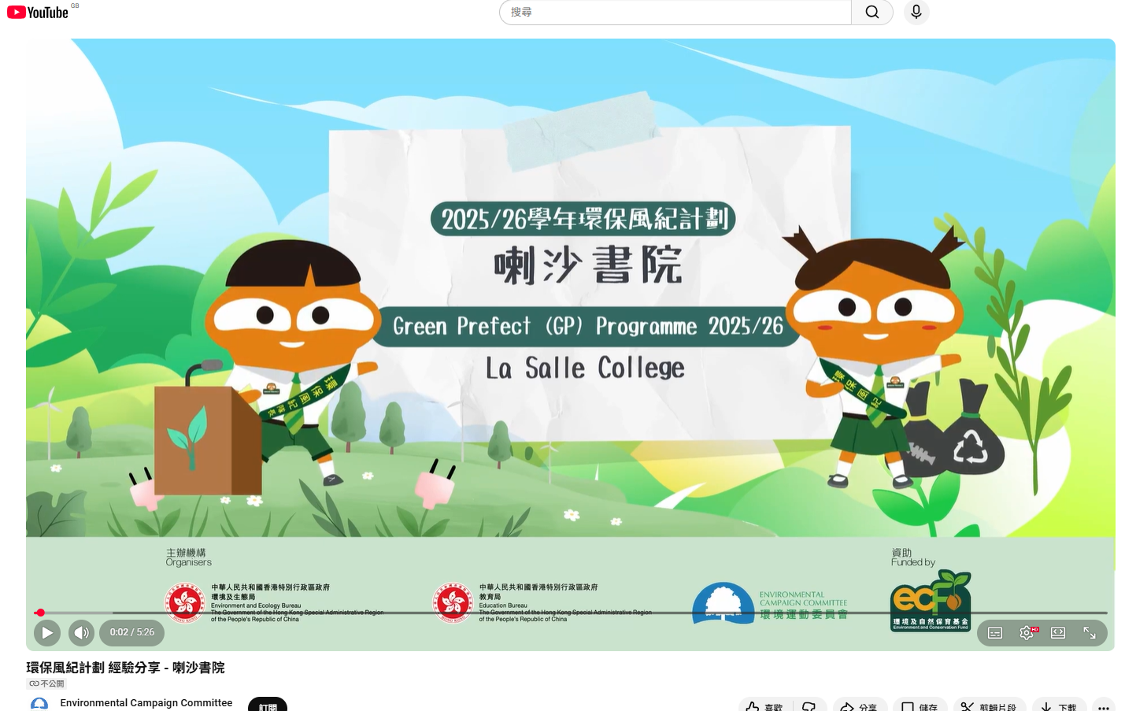


Reference Materials of GP Programme
Experience Sharing Video
Programme Website
Programme Handbook
Environmental Promotion Activity Record Form
https://school.ecc.org.hk/en/programmes/gpp.html

Slide 41
End

