Slide 1
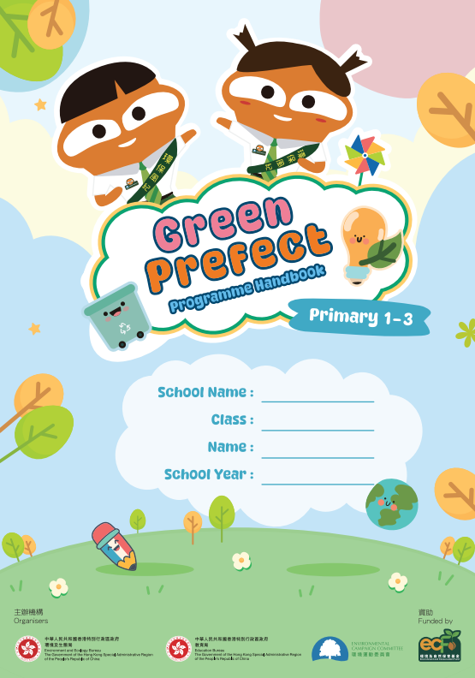


Green Prefect PROGRAMME
Environmental education programme 2026/27
Programme Handbook
Key Points
主辦機構
Organisers
資助
Funded by

Slide 2







Five Important Environmental Aspects

Slide 3



Energy Conservation
Over 60% of greenhouse gases emitted in Hong Kong come from electricity generation
Main energy source in Hong Kong is fossil fuels (coal and natural gas)
  Release large amounts of carbon dioxide when being burnt, leading to climate change
Air conditioning and lightings generally account for the majority of energy consumption in the education sector
Useful learning materials
(Primary Category)
(Secondary Category)
Conserve energy by using air conditioners and lights more efficiently on campus to help mitigate climate change
Notes:
Useful learning materials:
Primary Category (P.1 - 6): https://docs.google.com/document/d/1PY-wgaKkphMc5cx90X70WoRam7kEXs2e/edit
Secondary Category (F.1 – 6): https://docs.google.com/document/d/1cEAi6O8MRMF7554WRIj-NtCcwaFnBwFC/edit

Slide 4



Water Conservation
Water is an essential natural resource that we can use for drinking, bathing and household cleaning
Water resources on the Earth
  Most of them are saltwater that cannot be used directly
  Fresh water, which is available for usage, accounts for less than 1% of the
  total water supply
High domestic fresh water consumption of Hong Kong people
  Consuming about 150 litres of domestic fresh water per day per person
  Around 40 litres more than the global daily average
Useful learning materials
(Primary Category)
(Secondary Category)
Establish good water conservation habits to ease the water crisis
Notes:
Useful learning materials:
Primary Category (P.1 - 6): https://docs.google.com/document/d/1v2MrhjTC7zrf0_Y5_K0ES0DwdLz2dNOs/edit
Secondary Category (F.1 – 6): https://docs.google.com/document/d/1zNmgl8hggqc69ZIIVAEtUJF3LEfkzVtr/edit?usp=drive_link&ouid=113209333817763931204&rtpof=true&sd=true

Slide 5



Waste Avoidance & Reduction
Cities generate several types of solid waste every day, including waste from households, commercial and industrial activities
On average, people in Hong Kong generate 1.40 kg of municipal solid waste per day
  Higher than that of the neighbouring regions like Singapore (0.88 kg) and Tokyo (0.85 kg)
To solve the waste problem in Hong Kong, we should actively follow
the principle of "Dump Less, Save More, Recycle Right" as it helps
combat climate change and makes the best use of our limited land resources
Useful learning materials
(Primary Category)
(Secondary Category)
Avoid and minimise waste at source, reuse and cherish resources, and perform clean recycling
Notes:
Useful learning materials:
Primary Category (P.1 - 6): https://docs.google.com/document/d/1xitrVHc6HU_XHJiMj9Bnur5MRQIN23P4/edit
Secondary Category (F.1 – 6): https://docs.google.com/document/d/1kCfl7F2fj4hCRFZzEKMtJI0UCLR86Bdp/edit

Slide 6



Greening, Nature Conservation & Biodiversity
Hong Kong possesses natural coastlines and mountains
Over 40% of its land is designated as country parks, which serve as important habitats for wildlife
Apart from the countryside, a variety of plants, insects and birds can also be found within the urban areas
As members of nature, we have the responsibility to protect the natural environment and wildlife
Useful learning materials
(Primary Category)
(Secondary Category)
Actively learn about the flora and fauna on your campus and support campus greening to enhance biodiversity in your school and its surroundings
Notes:
Useful learning materials:
Primary Category (P.1 - 6): https://docs.google.com/document/d/13ifd8O4jZxnpcgRTUzPpGN9jy2EZqtZn/edit
Secondary Category (F.1 – 6): https://docs.google.com/document/d/1BIxvNFg3NIzO86OvNMi066iBk-yMyZwV/edit?rtpof=true&sd=true&tab=t.0

Slide 7



Clean Indoor Air
We spend most of our time indoors
Clean indoor air quality is crucial to our health and learning
  Prevent the spread of diseases
  Help us focus better
  Enhances our learning efficiency and performance
Useful learning materials
(Primary Category)
(Secondary Category)
Maintain good indoor air quality and effectively control pollutants in the air
Notes:
Useful learning materials:
Primary Category (P.1 - 6): https://docs.google.com/document/d/1Lw63DwGSSCeXWr723khfOZcBY6imf5W2/edit
Secondary Category (F.1 – 6): https://docs.google.com/document/d/1RnIeeapHgrnjFuRCoEoL5d-XbRU_ajqR/edit?usp=sharing&ouid=113209333817763931204&rtpof=true&sd=true

Slide 8

How to check?

Slide 9

Checking Frequency & GP Group Responsibilities
Frequency |  | At least once a month (November – May, a total of 7 months)
Role | Teacher Advisor | Discuss with GP Group to formulate best practices for each environmental aspect
 | GP Group | Plan the checking schedule and keep it confidential for surprise checks Use the environmental checklists to check students' environmental behaviours and the school's environmental performance regularly
* The Teacher Advisor can adjust the checking methods and frequency according to the actual circumstances. For example, the Teacher Advisor or Head GPs may arrange School GPs to check each class/floor regularly, or check and promote a designated environmental aspect for focused checking each month

Slide 10
Environmental checklist

Slide 11

Example of Filling in the Checklist
Checking |  |  | 1 | 2 | 3 | 4 | 5 | 6 | 7
Date |  |  | 04 11 | 02 12 | 12 01 | 16 02 | 02 03 | 12 04 | 05 05
Energy Conservation | E1. | Make use of the natural daylight as far as practicable and only switch on the essential lights on sunny days. | / | / | N | Y | Y | Y | Y
 | E2. | Turn off lights, computers and other electrical equipment (e.g. classroom TV, projectors, air purifiers, fans, air conditioners, etc.) when not in use. | / | Y | Y | N | Y | Y | Y
1. Input date of checking
2. Fill in the status for each checklist item
Achieved: “ Y ”
Partly achieved: “ / ”
Not yet achieved: “ N ”
Not applicable: “ NA ”

Slide 12
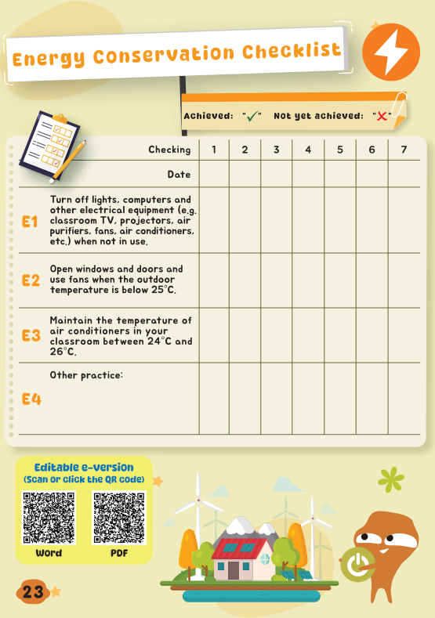
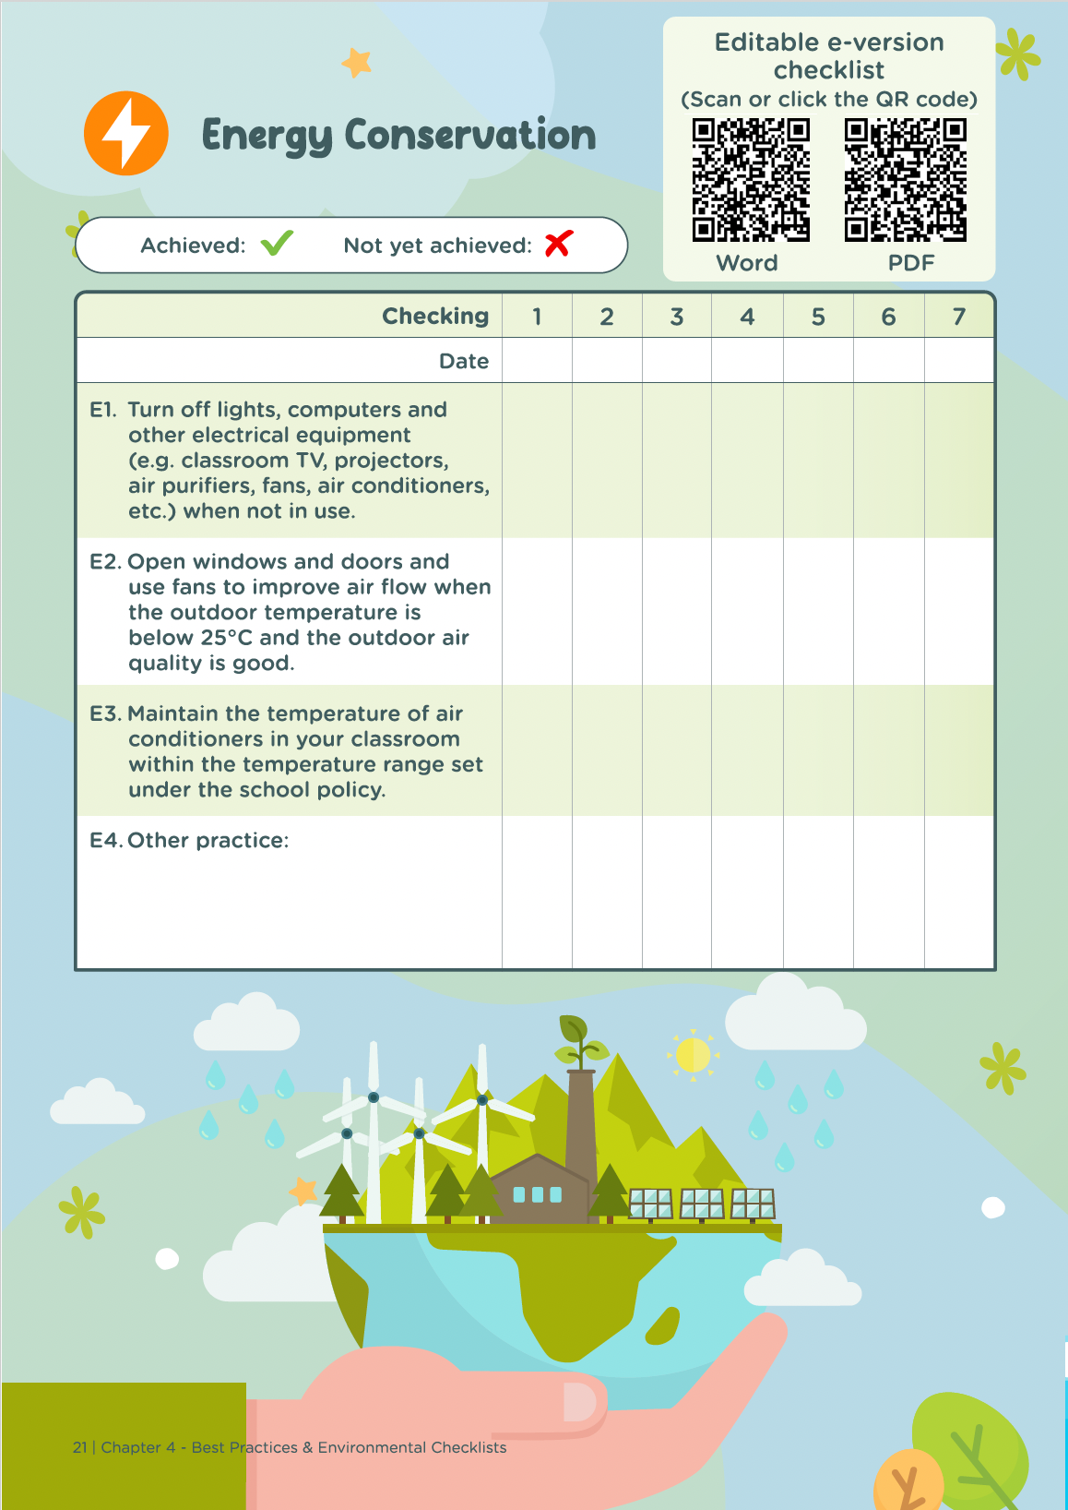
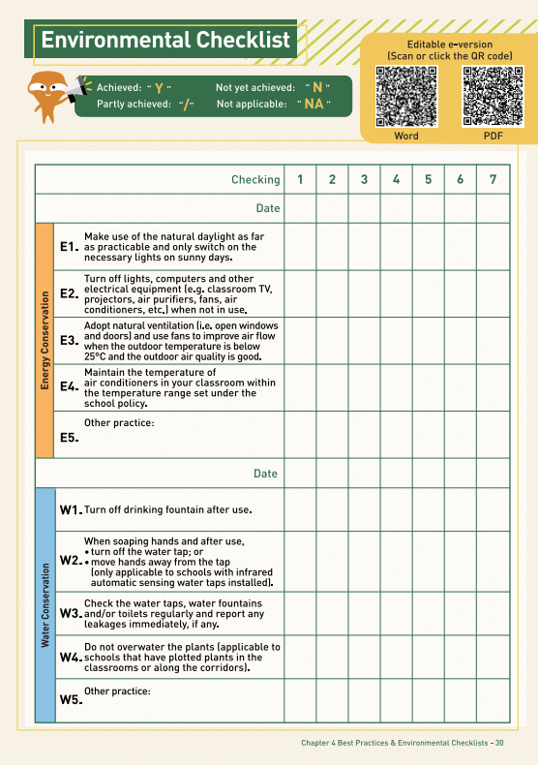
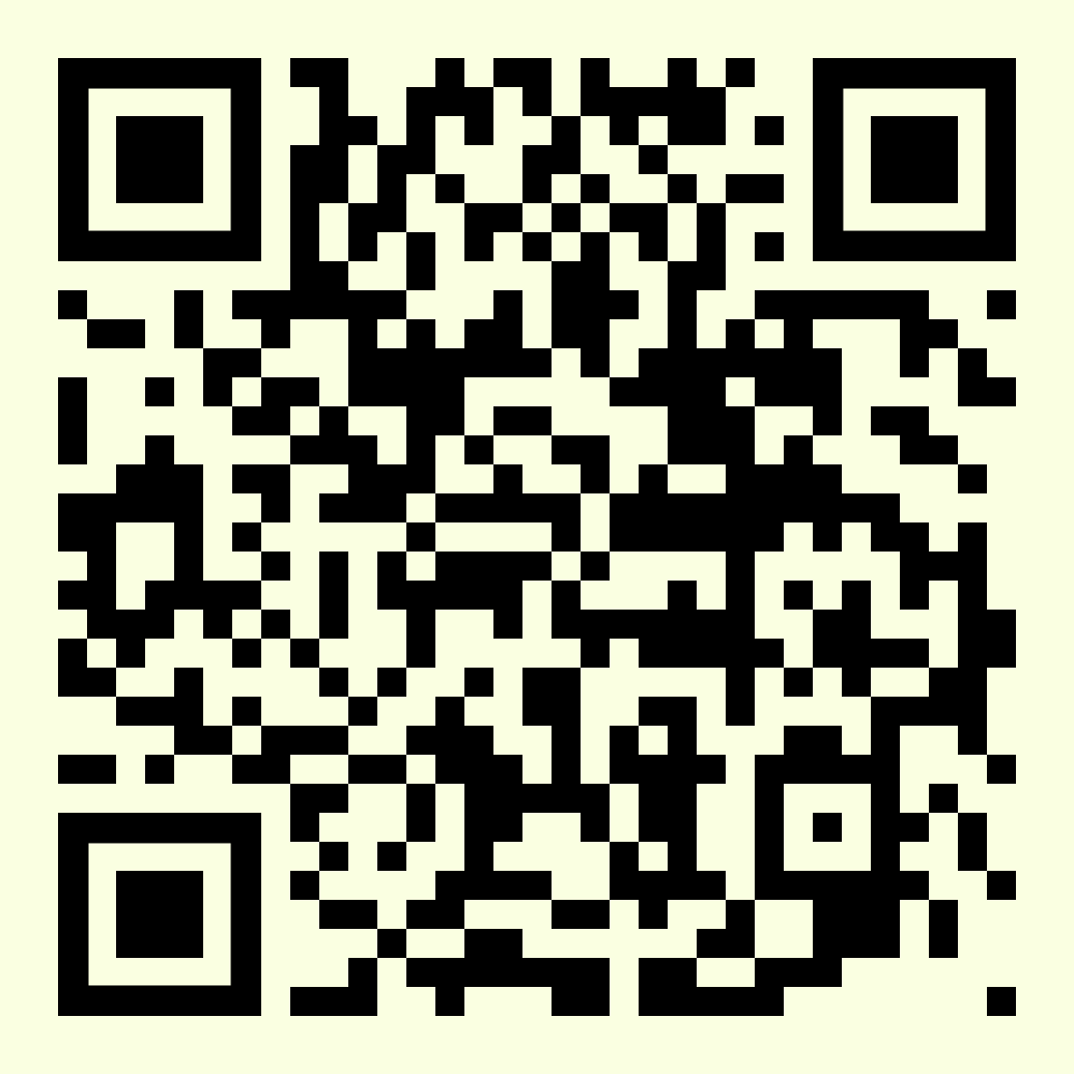
Environmental Checklists
For reference only
The environmental checklists can be revised according to the school setting by adding, modifying or deleting non-applicable items
Editable versions in Microsoft Word and PDF formats can be downloaded here
Notes:
https://school.ecc.org.hk/en/resources/forms.html#gpp

Slide 13

Energy Conservation
Best Practice |  | Checking Method (Example)
E1. | Make use of the natural daylight as far as practicable and only switch on the essential lights on sunny days. Tips: Divide the classroom lighting system into regular use and supplementary lights, and place labels on the switches to indicate the lighting arrangement for sunny and cloudy days. | When there is sufficient daylight, check if natural daylight is being utilised and only essential lights have been turned on.
E2. | Turn off lights, computers and other electrical equipment (e.g. classroom TV, projectors, air purifiers, fans, air conditioners, etc.) when not in use. | When the classroom/special room is unoccupied, check if the electrical equipment have been turned off.

Slide 14

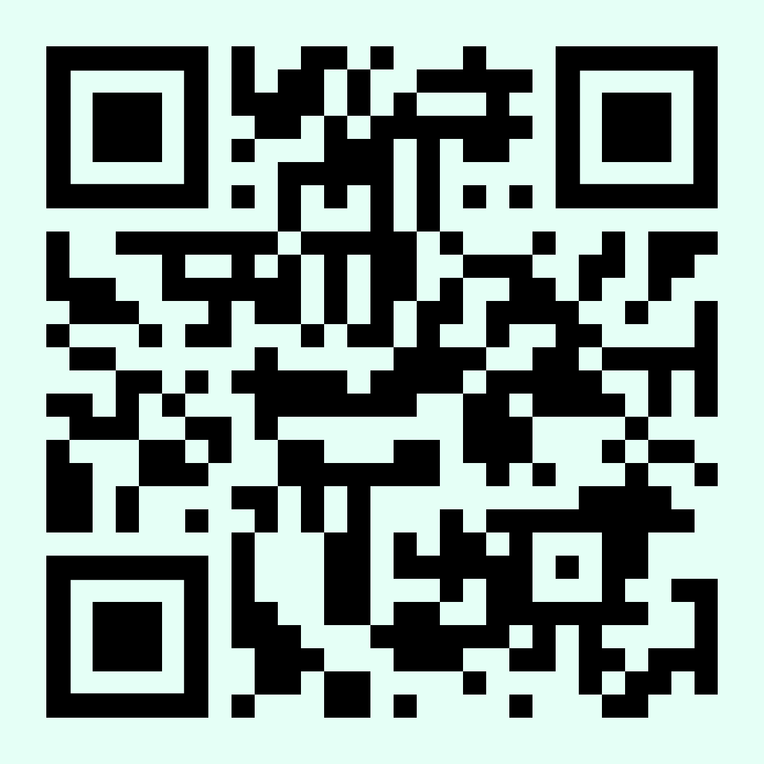
Energy Conservation (Cont.)
Best Practice |  | Checking Method (Example)
E3. | Adopt natural ventilation (i.e. open windows and doors) and use fans to improve air flow when the outdoor temperature is below 25°C and the outdoor air quality is good. Tips: Install a thermometer in the school's covered playground for easy checking of outdoor temperature. Place the thermometer away from direct sunlight and rain. | Check the Hong Kong Observatory (HKO)'s forecast for maximum temperature and the Environmental Protection Department (EPD)'s Air Quality Health Index (AQHI) in the morning based on the school's location. If the maximum temperature of the forecast or school's outdoor thermometer is below 25°C and the AQHI is low, observe whether natural ventilation is adopted and/or fans are used.
HKO’s Weather Forecast
EPD’s AQHI
Notes:
HKO: https://www.hko.gov.hk/en/
EPD’s AQHI: https://www.aqhi.gov.hk/en/index.html

Slide 15
Energy Conservation (Cont.)
Best Practice |  | Checking Method (Example)
E4. | Maintain the temperature of air conditioners in your classroom within the temperature range set under the school policy. Tips: Install a thermometer in the classroom for easy checking of indoor temperature. Set and maintain the average indoor temperature between 24°C and 26°C. If additional cooling is needed, for example, after Physical Education classes, use fans to enhance air circulation instead of lowering the air conditioning temperature. | Read the temperature displayed on the classroom thermometer and check if the temperature of the air conditioners in the classroom is maintained within the range set by the school policy.
Notes:
HKO: https://www.hko.gov.hk/en/
EPD’s AQHI: https://www.aqhi.gov.hk/en/index.html

Slide 16
Water Conservation
Water Conservation
Best Practice |  | Checking Method (Example)
W1. | Turn off drinking fountain after use. Tips: If the school has installed smart water dispensers, this item can be omitted. | Observe classmates' behaviour for 10 minutes during recess/lunch break.
W2. | When soaping hands and after using the tap, turn off the water tap; or move hands away from the tap sensor (only applicable to schools with infrared automatic sensing water taps installed). | Observe classmates' behaviour for 10 minutes during recess/lunch break.
W3. | Check the water taps, water fountains and/or toilets regularly and report any leakages immediately, if any. | Check the condition of water taps, water dispensers and other equipment regularly.
W4. | Do not overwater the plants (applicable to schools that have plotted plants in the classrooms or along the corridors). | Monitor classmates' plant watering habits and check for excessive water accumulation at the bottom of potted plants.

Slide 17
Waste Avoidance & Reduction (Food Waste)
Best Practice |  | Checking Method (Example)
R1. | No significant amount of leftover is generated. Tips: Leftovers refer to discarded edible food, including food wasted due to picky eating. Schools are recommended to implement on-site meal portioning to allow flexible control over the amount of food served to students. | During lunch break, randomly check 5 classmates’ lunchboxes. If 4 of them have no leftovers, the target is considered achieved.
R2. | Separate food waste from lunchboxes, cutlery and/or containers to facilitate food waste recycling, if any. Tips: Food waste refers to uneaten or inedible materials that are discarded, including bones and peels. Schools are recommended to set up food waste collection bins and install composters to convert food waste into compost for campus gardening. | Observe classmates' behaviour in food waste separation and recycling for 10 minutes during lunch break.

Slide 18
Waste Avoidance & Reduction (Paper)
Best Practice |  | Checking Method (Example)
R3. | Use handkerchiefs/towels instead of paper towels. | Observe classmates' behaviour for 10 minutes during recess/lunch break. Randomly select 5 classmates to check if they have the habit of bringing their own handkerchief/towel.
R4. | Put one-side-used paper into the appropriate collection box. Tips: Schools are recommended to set up collection boxes for one-side-used paper and double-side-used waste paper separately to facilitate students’ reuse of one-side-used paper. | Check the one-side-used paper collection box and observe classmates' behaviour for 10 minutes during recess/lunch break.
R5. | Use both sides of the paper and put double-side-used waste paper into the recycling bin. | Check the double-side-used waste paper recycling bin and observe classmates' behaviour for 10 minutes during recess/lunch break.

Slide 19
Waste Avoidance & Reduction (Plastics)
Best Practice |  | Checking Method (Example)
R6. | Bring your own water bottle. | Observe classmates' behaviour for 10 minutes during recess/lunch break. Conduct surprise checks to count and record the number of students who have brought their own reusable water bottles to school in each class on a given day.
R7. | Stop buying bottled water and/or drinks. | Observe classmates' behaviour for 10 minutes during recess/lunch break. Randomly select 5 students to check if they have bought bottled water and/or drinks.
R8. | Drink without plastic straw or use reusable straws when necessary. | Observe classmates' behaviour for 10 minutes during recess/lunch break. Randomly select 5 classmates to check if they have used plastic straws.
R9. | Use reusable meal boxes, cups, bowls and cutlery (such as spoons, forks, etc.) at school. | Observe classmates' behaviour for 10 minutes during lunch break. Conduct surprise checks to count and record the number of students who have brought reusable utensils to school in each class on a given day.

Slide 20
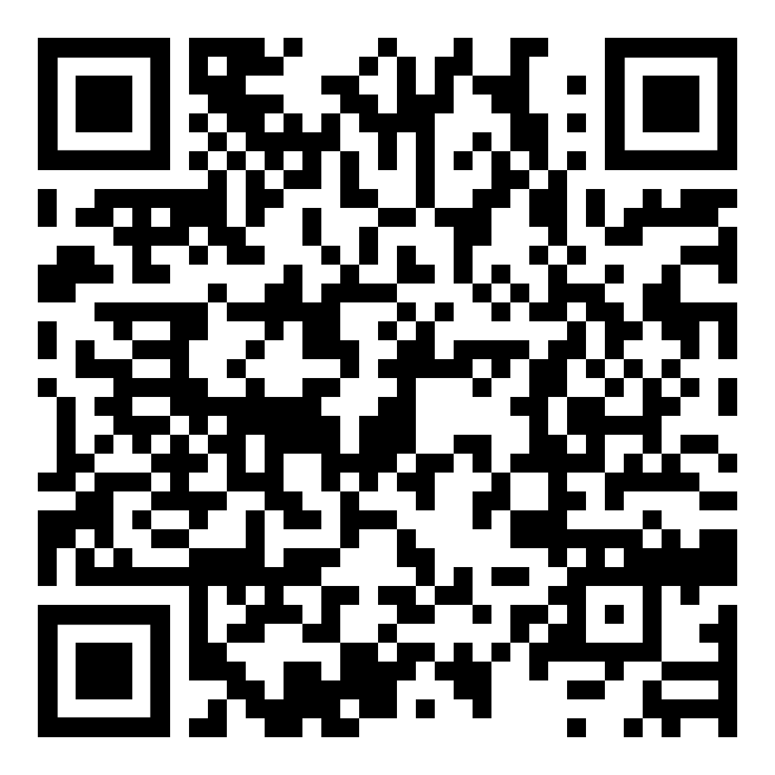
Waste Avoidance & Reduction (Reuse & Recycle)
Best Practice |  | Checking Method (Example)
R10. | Reuse folders. | Observe classmates' behaviour for 10 minutes during recess/lunch break.
R11. | Use recyclables to make decorative items at school events (such as parties, sports days, picnics, outings, fun fairs, open days, etc.). | Observe decorative items of classmates/classrooms at school events.
R12. | Collect printer cartridges for recycling. | Check the printer cartridges recycling bin(s) during recess/lunch break.
R13. | Practise clean recycling. Tips: Recyclables (metal cans, plastics and beverage cartons) should be clean and free from impurities before being placed in the appropriate recycling bins. Remove staples and tapes on waste paper before being placed in the appropriate recycling bins. | Observe classmates' behaviour for 10 minutes during recess/lunch break. Check whether the recyclable items are placed in the appropriate recycling bins and are clean and free from impurities.
Clean Recycling Guideline
Notes:
Clean Recycling Guideline: https://www.wastereduction.gov.hk/en-hk/waste-reduction-programme/clean-recycling

Slide 21
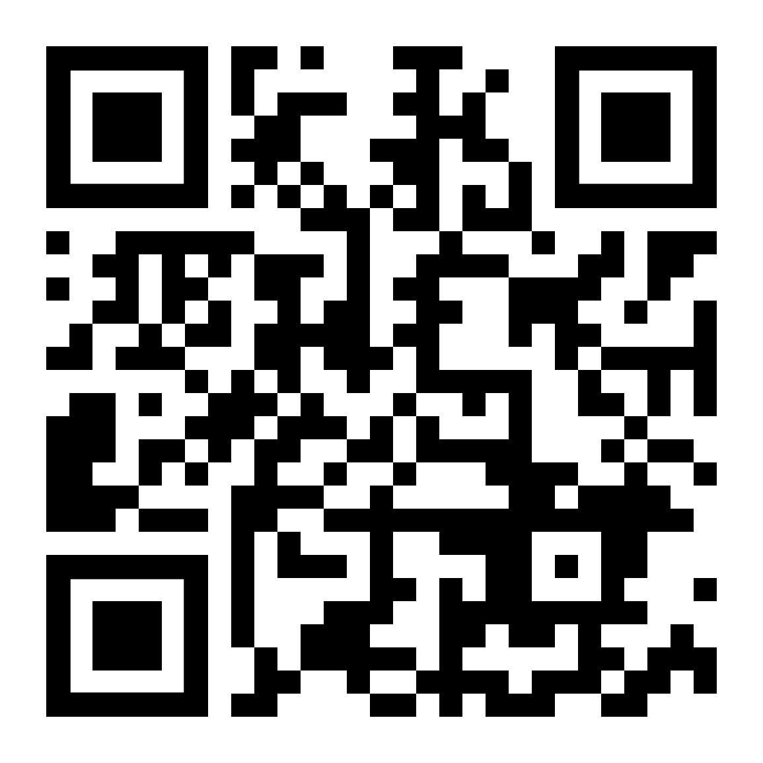
Greening, Nature Conservation & Biodiversity
Best Practice |  | Checking Method (Example)
G1. | Grow and look after plants in the classroom/along the corridor/green area/organic farm, if any. | Develop a routine duty record for caring for the campus plants. Check their growth and health regularly.
G2. | Use organic fertilisers (such as compost) as appropriate. | Develop a routine record to check if organic fertilisers have been used for plants on campus.
G3. | Record the diversity of flora and fauna (the number of species) on campus regularly. Tips: Conduct ecological citizen science surveys using iNaturalist, which helps identify the species found on the campus. | Develop a duty record and a biodiversity record sheet for conducting ecological surveys on campus.
iNaturalist
Notes:
iNaturalist: https://www.inaturalist.org/

Slide 22
Greening, Nature Conservation & Biodiversity (Cont.)
Best Practice |  | Checking Method (Example)
G4. | Practise "Leave No Trace" during school outings (e.g. school picnics, visits to country parks/geoparks, etc.). Tips: "Leave No Trace" is a set of principles aimed at reducing the negative impacts of humans on the natural environment. The seven principles include "Take Your Litter Home", leave what you find, respect wildlife, etc. | Observe classmates' behaviour (e.g. use reusable water bottle and lunchbox, "Take Your Litter Home") before leaving the countryside.
Notes:
iNaturalist: https://www.inaturalist.org/

Slide 23
Clean Indoor Air
Best Practice |  | Checking Method (Example)
A1. | Keep the rubbish bin in the classroom clean and covered with a lid properly after use. | Observe the rubbish bin in your classroom during recess/lunch break and check if it is clean without strong smells and properly covered.
A2. | Keep the food waste collection bins and/or composters on campus clean and ensure the lids are tightly closed after use, if any. Tips: Place the food waste collection bins and composting machines in well-ventilated areas on campus or install ventilation systems to enhance air circulation and prevent the spread of odour from food waste. | Check the food waste collection bins and/or composters during lunch break to ensure they are clean and properly covered.
A3. | Keep the seats and classroom clean and free of dust. | Check if classmates' seats and the classroom are tidy and clean during recess, lunch break or after school.

Slide 24
Clean Indoor Air (Cont.)
Best Practice |  | Checking Method (Example)
A4. | Clean up food or drink spills immediately to prevent mould or bacterial growth, if any. | Check if classmates' seats and the classroom are tidy and clean during recess, lunch break or after school.
A5. | Do not use stationery containing high level of volatile organic compounds (VOCs), such as marker pens or correction fluids, in the classroom. | Check the stationery in the classroom during recess, lunch break or before/after school.
A6. | Timely activate the air purifier in the classroom, if any. | Check if the air purifier in the classroom is turned on before the morning class starts. When the classroom is unoccupied, check if the air purifier is turned off to conserve energy.

Slide 25
Environmental Promotion activities

Slide 26
Activities & Promotion methods (Examples)
For the School
Activities
Sharing via morning announcements, assemblies, classroom presentations, etc.
Drama
Sharing on-campus TV or radio
Environmental talk/sharing
Inter-class competitions/quiz contests
Green idea competitions
Themed Environmental Day/Week
Decorating bulletin boards/campus with eco-friendly materials
Co-organising environmental activities with alumni associations/parent-teacher associations
Publicity
Posters/bulletin boards
Slogans
Green tip labels
Environmental promotional videos
Environmental information booths
Newsletters of the school/alumni associations/parent-teacher associations
Social media platforms
School website

Slide 27
Activities & Promotion methods (Examples) (Cont.)
For the Community
Activities
Green community events
Inter-school competitions
Publicity
Open day exhibitions
Social media platforms
School website
School's newsletters

Slide 28

How to plan and organise environmental promotion activities?
Review the school’s resources, and evaluate it’s strengths and weaknesses
Examples of Environmental Hardware
LED energy-efficient lights | Water dispensers
Real-time energy monitoring systems | Green spaces
Flow controllers for water taps | Organic farming areas
Rainwater collection barrels | Air purification devices
Recycling bins | Environmental corner (publication on environmental-related information)
Food waste composters
Examples of Software Resources
Environmental Club | School social media platforms, websites
Geography Club | Morning assembly announcements
Biology Club | Organising eco-tours
Campus TV/radio | Incorporating eco-friendly elements into the school events

Slide 29
Activity Proposal Framework
Develop an activity proposal basing on the review and findings collected
Target Environmental Aspect | All or one of them?
Activity Name | Use your creativity to name the activity and attract your peers to join!
Date, Time & Venue | Post-exam activity? During recess or lunch break? Before or after school hours? Duration of the activities? Indoor or outdoor? Off-campus visit?
Aim | What specific environmental messages would you like to convey?

Slide 30
Activity Proposal Framework (Cont.)
Target Audience (Participants) | Inter-class or whole-school activity? Is student participation compulsory or voluntary? Expected number of participants? School staff included? Parents involved?
Format | Recall the past events organised by the school, which types of activities are more popular among students? One-time or regular activities? Incentives/a competitive element included?
Resources & Budget Needed | How to develop a duty roster to assign tasks and responsibilities among the GP Group? How to utilise resources from different parties effectively? Evaluation and appraisal system needed for further improvement?

Slide 31
Environmental Promotion activities (EXAMPLES)

Slide 32

Example 1 – Example of Promotion Activity for All Environmental Aspects
Activity Name | Green Campus Exploration
Date, Time & Venue | Date: 3 – 5 November Time: 12:30 – 13:00 (Lunchtime) Venue: Environmental facilities on campus
Aim | To raise students' awareness towards the concept of a green campus and familiarise them with the environmental facilities on campus Learn the proper use of the environmental facilities
Participants | All students and school staff
Content | The activity will take place during lunchtime for three consecutive days for students to participate in it voluntarily Students will use a treasure map to discover various environmental facilities within the school, such as the environmental corner, recycling bins, food waste composting machines, water dispensers, flow controllers for water taps, thermometers, green spaces, etc. School GPs will station at each environmental facility to introduce the environmental concepts behind, such as waste reduction at source and clean recycling, and demonstrate the proper way to use the facility After listening to the School GPs' introduction, students will complete a quiz game based on the map
Responsibilities | The GP Group to prepare the introduction materials and the treasure map worksheet The GP Group to promote the activity (such as during morning assemblies and through campus radio) The Head GPs to create a duty roster and arrange School GPs to provide on-site assistance

Slide 33
Example 2 – Energy Conservation
Part A |  | Part B
Activity Name | Be the Energy Inventor | "Be the Energy Inventor" Exhibition
Date, Time & Venue | Date: 7 – 11 December | Date: 15 – 18 December Time: Recess, lunchtime and/or after school Venue: Covered Playground
Aim | To raise students' interest towards STEAM and energy To allow students to apply knowledge on energy efficiency, renewable energy and resource reutilisation | To allow participants to appreciate the creative work pieces of the "inventors" (students participated in Part A) To enhance participants' knowledge on renewable energy and resource reutilisation
Participants | All students | All students and school staff
Content | Intra-school competition Open recruitment Design and create an environmentally friendly device which could generate electricity by using waste materials | Showcase inventions of the "inventors" along with descriptive text Introduce renewable energy to the participants
Responsibilities | The Teacher Advisor to form an assessment panel The GP Group to promote the competition and prepare environmental prizes | The "inventors" (students participated in Part A) to demonstrate the use of their inventions and share about their experience The GP Group to design display boards to introduce different types of renewable energy to the participants The GP Group to encourage the participants to be committed to energy conservation

Slide 34
Example 3 – Water Conservation
Part A |  | Part B
Activity Name | "Save water, Save us" Exhibition | Inter-class Water Conservation Quiz Competition
Date, Time & Venue | Date: 18 – 22 January Venue: School Library | Date: 28 – 30 January Venue: School Hall
Aim | To enhance the knowledge of water conservation
Participants | All students and school staff
Content | Place display boards with text and photos on water resources and water conservation | Each class sends three participants to join the inter-class competition The competition will be divided into Form 1 to Form 3 Groups and Form 4 to Form 6 Groups The winning class from each group will receive environmental prizes
Responsibilities | The GP Group to design display boards to showcase information about water conservation The GP Group and the Teacher Advisor to create worksheets to reinforce students' knowledge The Teacher Advisor to contact the School Library staff | The GP Group to promote the activity The GP Group to set quiz questions, set up the venue and prepare the environmental prizes The Teacher Advisor to approve the quiz questions and answers

Slide 35
Example 4 – Waste Avoidance & Reduction
Part A |  | Part B
Activity Name | Visit to EPD's EcoPark and WEEE·PARK | Sharing at school after the visit
Date, Time & Venue | Date: 5 March Time: 15:00 – 16:00 Venue: EcoPark & WEEE·PARK (Tuen Mun) | Date: 9 March Time: 08:30 – 09:00 Venue: School Hall
Aim | To enhance the knowledge of waste recycling technologies To understand the operation of waste recycling industry in Hong Kong
Participants | 20 students and teachers (including GP Group members & other schoolmates) | All students and teachers
Content | Open recruitment Visit EPD’s EcoPark and WEEE·PARK | Share the visit experience through presentations and videos Introduce waste recycling facilities and promote messages of source reduction and clean recycling
Responsibilities | The Teacher Advisor to contact EcoPark & WEEE·PARK and arrange the visit (EcoPark: 2496 7633, WEEE · PARK: 2290 9500) The GP Group to promote the activity | Sharing by GPs and/or students who participated in Part A

Slide 36
Example 4 – Waste Avoidance & Reduction (Cont.)
Part C
Activity Name | GREEN@School – Clean Recycling Campaign
Date, Time & Venue | Date: 9 March – 9 April (Every Tuesday and Friday) Time: 10:00 – 10:20 (Recess) Venue: Covered Playground
Aim | To teach and encourage all students and school staff to practise waste separation and clean recycling (including plastic bottles, metal cans, beverage cartons (tetra pak), etc.)
Participants | All students and school staff
Content | Special recycling points will be set up on campus during the campaign Students and teachers will bring emptied and cleaned recyclables to the collection points Each recyclable item will earn points, and students and school staff can accumulate points to redeem eco-friendly gifts or rewards such as organic crops from the school All collected recyclables will be taken to the nearby "GREEN@COMMUNITY" or handled by the school's waste recycling contractor every week Display boards will be set up to showcase the GREEN@COMMUNITY recycling service and information about the GREEN$ Electronic Participation Incentive Scheme
Responsibilities | The GP Group to design posters and display boards providing instructions for waste separation and clean recycling, as well as information about the "GREEN@COMMUNITY" The Head GPs to create a duty roster and arrange School GPs to provide on-site assistance at the recycling points The GP Group to record and track the quantities of different recyclables collected and the performance of different grades The GP Group to promote the activity and share the results of the campaign during morning assemblies and through campus radio

Slide 37
Example 5 – Greening, Nature Conservation & Biodiversity
Part A |  | Part B
Activity Name | Campus Bioblitz Week | Our Campus Little Creatures
Date, Time & Venue | Date: 20 – 23 April Time: After school Venue: Greening space on campus | Date: 28 April Time: 08:30 – 09:00 Venue: School Hall
Aim | To enhance students’ and teachers’ knowledge of urban ecology and biodiversity To appreciate the biodiversity on campus
Participants | 20 students and teachers per day (including GP Group members & other schoolmates) | All students and teachers
Content | Observe wildlife on campus with binoculars and cameras, and record on the record sheets Upload photos to iNaturalist for species identification | Share the survey results in the form of presentations, photos and videos Upload relevant presentations, photos and videos to the school website to share the survey results with the community after the activity
Responsibilities | The Teacher Advisor to borrow binoculars and cameras from the laboratory staff The GP Group to prepare the record sheets The GP Group to collect and analyse the survey results The GP Group to promote the activity | The GPs and/or students participated in Part A to share about their experiences and create videos Students to encourage their parents to visit the school website to view the survey results

Slide 38
Example 6 – Clean Indoor Air
Part A |  | Part B
Activity Name | Participate in "Understanding Indoor Air Quality (IAQ)" activities organised by EPD
Date, Time & Venue | Presentation | Interactive IAQ models and exhibition
Aim | Date: 4 May Time: 13:30 – 14:00 Venue: School Hall | Date: 5 – 12 May Venue: School Library
Participants | To enhance students’ and teachers’ knowledge on IAQ To understand the importance of good IAQ to our health
Content | All students & teachers
Responsibilities | The Teacher Advisor to contact EPD (EPD: 2788 6177) The GP Group to promote the activity The GP Group and the Teacher Advisor to create worksheets to reinforce students’ knowledge

Slide 39
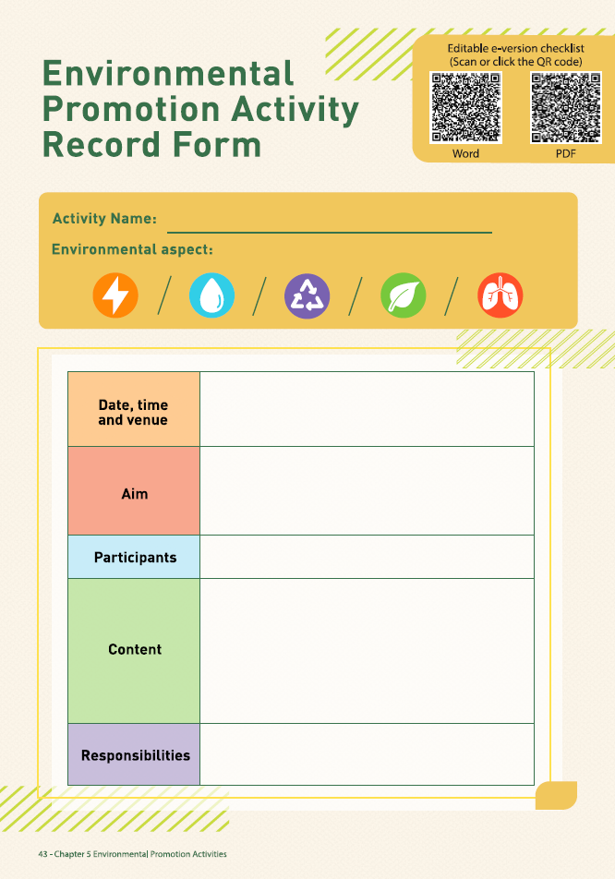
Environmental Promotion Activity Record Form
Editable versions in Microsoft Word and PDF formats can be downloaded here
Notes:
https://school.ecc.org.hk/en/resources/forms.html#gpp

Slide 40



More Information
Programme Handbook & relevant materials
Introduction PowerPoint
Briefing video
Promotional materials
Experience sharing video of past participating schools
Green Prefect Programme Official Website
Enquiries
  Environmental Campaign Committee
    Tel: 2835 1738
    Email: schools@eeb.gov.hk
    Fax: 2909 9577
  Technical Consultant – The Conservancy Association
    Tel: 2272 0301
    Email: education.cahk@gmail.com
Notes:
Green Prefect Programme Official Website: https://school.ecc.org.hk/en/programmes/gpp.html
Programme Handbook and relevant materials, Introduction PowerPoint, Briefing video, Promotional materials, Experience sharing video of past participating schools: https://school.ecc.org.hk/en/resources/forms.html#gpp

